Slide 1
Graphical models, conditional independence and explaining away
Nikolaus Kriegeskorte, 29 October 2013
9. What is a graphical model and how is it related to a multivariate probability distribution?
10. What is a Bayesian network (or Bayes net)?
11. What is “explaining away”?
12. How can Bayesian inference be performed on complex models?

Slide 2
(1) Graphical models

Slide 3
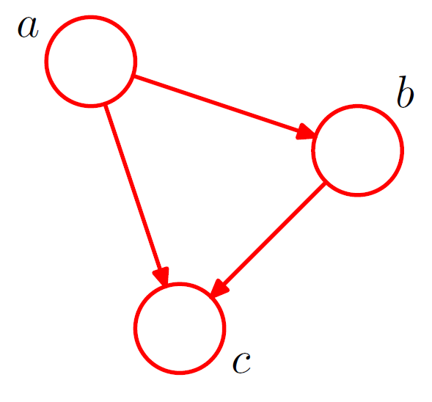

Slide 4
True or false?
A graphical model can represent causal relationships.
Variable c is a linear combination of a and b.
If we know a and b, we know c.
Variables a and b independently influence c.
✓
✗
✗
✗

Slide 5
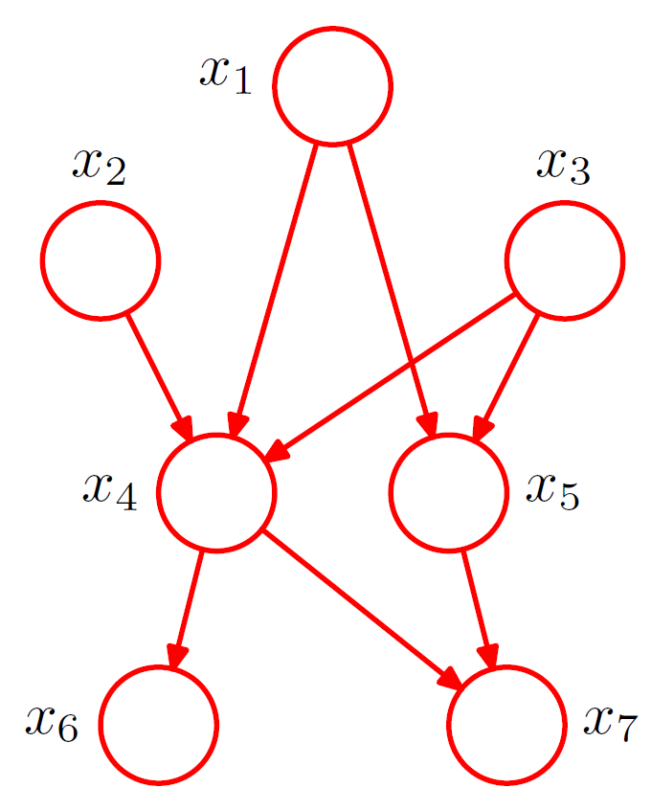

Slide 6
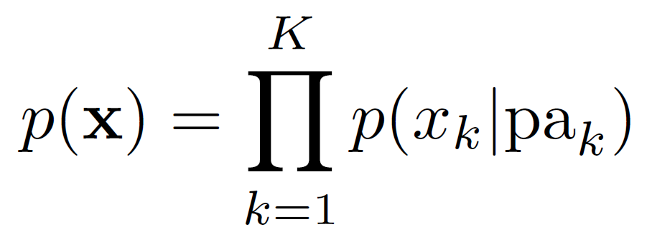
General rule for turning a graphical model into a product of probability functions

Slide 7
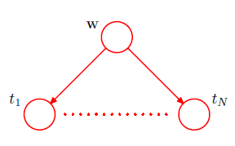
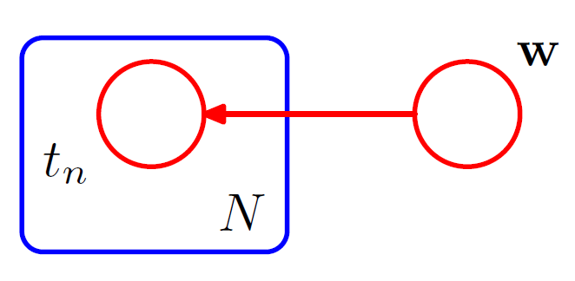
Plate notation

Slide 8
Graphical models factorise, and thus simplify, joint probability densities
K
K

Slide 9
(2) statistical independence

Slide 10
Independence
p(x)
p(y)
p(x,y)
p( x | y=y1 ) = p( x | y=y2 ), for all y1, y2
p(x,y) = p(x) p(y)

Slide 11
Independence
For which of the following bivariate distributions are X and Y indpendent?
Y
X
✗
✗
✗
✓
Stone, Trends in Cognitive Sciences, 2002

Slide 12
(3) multinormal distribution

Slide 13
Multivariate normal distribution
any multidimensional distribution that can be obtained as the outer product of univariate Gaussians along orthogonal axes.
Axes need not coincide with the original axes (can be rotated).
Widths of unidimensional Gaussians may vary.

Slide 14
Conditional probability

Slide 15
Outer product of two identical Gaussians is rotation-invariant
p(y)
p(x)
Thus:
any oblique marginal sum is Gaussian
any oblique slice is Gaussian (conditional probability)
p(x,y)

Slide 16
Outer product of two identical Gaussians is rotation-invariant
r
y
x
Thus:
any oblique marginal sum is Gaussian
any oblique slice is Gaussian (conditional probability)

Slide 17
Any multivariate normal can be obtained by stretching and rotation of an isotropic multinormal
Thus, as for the isotropic case, all oblique marginals and slices are Gaussian for multinormals in general.

Slide 18
(4) conditional independence

Slide 19
Conditional independence

Slide 20
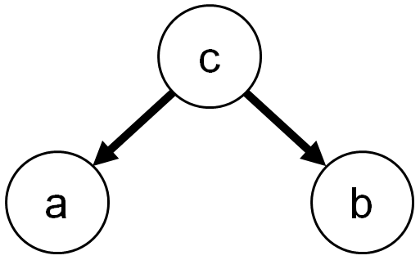
Conditional independence
c
p(a,b,c) = p(a|c) p(b|c) p(c)
a
= c+noise
b
= c+noise
p(a,b|c) = p(a,b,c) / p(c)
= p(a|c) p(b|c)

Slide 21
Conditional independence
c
p(a,b,c) = p(a|c) p(b|c) p(c)
a
= c+noise
b
= c+noise
p(a,b|c) = p(a,b,c) / p(c)
= p(a|c) p(b|c)

Slide 22
Conditional independence
c
p(a,b,c) = p(a|c) p(b|c) p(c)
a
= c+noise
b
= c+noise
p(a,b|c) = p(a,b,c) / p(c)
= p(a|c) p(b|c)

Slide 23
Conditional independence
c
p(a,b,c) = p(a|c) p(b|c) p(c)
a
= c+noise
b
= c+noise
p(a,b|c) = p(a,b,c) / p(c)
= p(a|c) p(b|c)

Slide 24
Conditional independence
c
p(a,b,c) = p(a|c) p(b|c) p(c)
a
= c+noise
b
= c+noise
p(a,b|c) = p(a,b,c) / p(c)
= p(a|c) p(b|c)

Slide 25
(5) EXPLAINING AWAY

Slide 26
Explaining away
c = a+b+noise
p(a,b,c) = p(c|a,b) p(a) p(b)
a
b
p(a,b|c) = p(a,b,c) / p(c)
= p(c|a,b) p(a) p(b)
/ p(c)

Slide 27
Explaining away
c = a+b+noise
p(a,b,c) = p(c|a,b) p(a) p(b)
a
b
p(a,b|c) = p(a,b,c) / p(c)
= p(c|a,b) p(a) p(b)
/ p(c)

Slide 28
Explaining away
c = a+b+noise
p(a,b,c) = p(c|a,b) p(a) p(b)
a
b
p(a,b|c) = p(a,b,c) / p(c)
= p(c|a,b) p(a) p(b)
/ p(c)

Slide 29
Explaining away
c = a+b+noise
p(a,b,c) = p(c|a,b) p(a) p(b)
a
b
p(a,b|c) = p(a,b,c) / p(c)
= p(c|a,b) p(a) p(b)
/ p(c)

Slide 30
Explaining away
c = a+b+noise
p(a,b,c) = p(c|a,b) p(a) p(b)
a
b
p(a,b|c) = p(a,b,c) / p(c)
= p(c|a,b) p(a) p(b)
/ p(c)

Slide 31
Explaining away
c = a+b+noise
p(a,b,c) = p(c|a,b) p(a) p(b)
a
b
p(a,b|c) = p(a,b,c) / p(c)
= p(c|a,b) p(a) p(b)
/ p(c)

Slide 32
Explaining away
Flanders
murderer
innocent
murderer
innocent
innocent
innocent
innocent
Fridge
none
lettuce
lettuce
none
lettuce
none
none
c
a
b

Slide 33
(6) the symmetry of conditional independence and explaining away

Slide 34
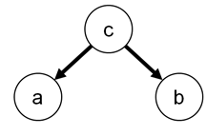
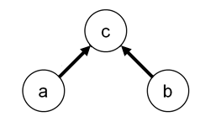
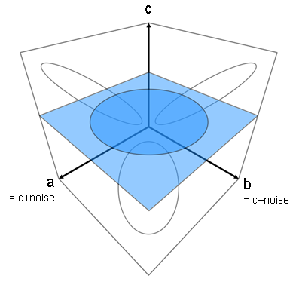
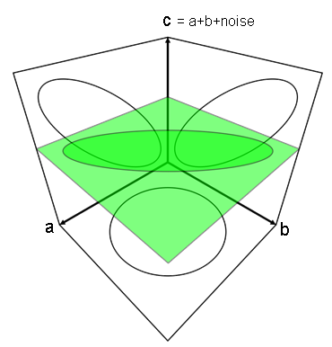
Conditional independence
Explaining away

Slide 36
[alternative/additional slides]

Slide 37
Explaining away

Slide 38
Explaining away
c = a+b+noise
a
b

Slide 39
Univariate normal distribution (also called Gaussian)
width and location
standard deviation
maximum probability density
essentially...

Slide 40
Covariance matrix
t = 1 2 3 . . . n_{time}

Slide 41
Multivariate normal distribution
dimensionality
matrix inversion
coordinate vector
covariance matrix
normalization to sum of 1
mean vector

