Slide 1

Neural mechanisms underlying repetition suppression in occipitotemporal cortex
Michael Ewbank
MRC Cognition and Brain Sciences Unit, Cambridge, UK.

Slide 2
Repetition suppression/adaptation
“A neural system’s temporary reduction in responsiveness to a stimulus after prolonged exposure to the stimulus”.
Visual adaptation to low-level properties (e.g. orientation, colour) and high-level attributes (facial expression, identity, gender).
fMR-adaptation (Grill-Spector & Malach, 2001) - the reduction in BOLD signal following repeated presentation of the same stimulus.

Slide 3
Repetition suppression/adaptation
fMRI-adaptation is used to probe response properties of cortical regions–
A neuronal population can be adapted by repeated presentation of the same stimulus
Vary some attribute of the stimulus (e.g. size) and measure any subsequent release from adaptation.
If adaptation persists despite these changes it would indicate the underlying neuronal population are invariant to that attribute.

Slide 4
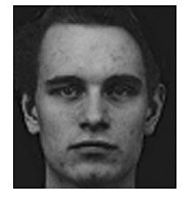
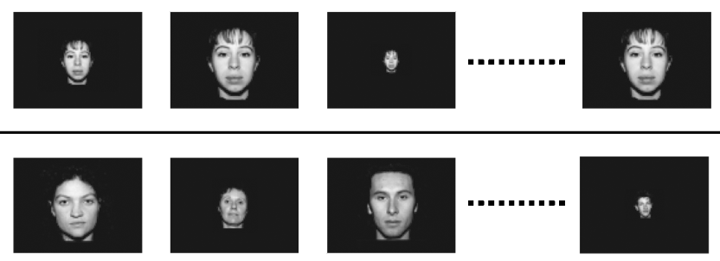
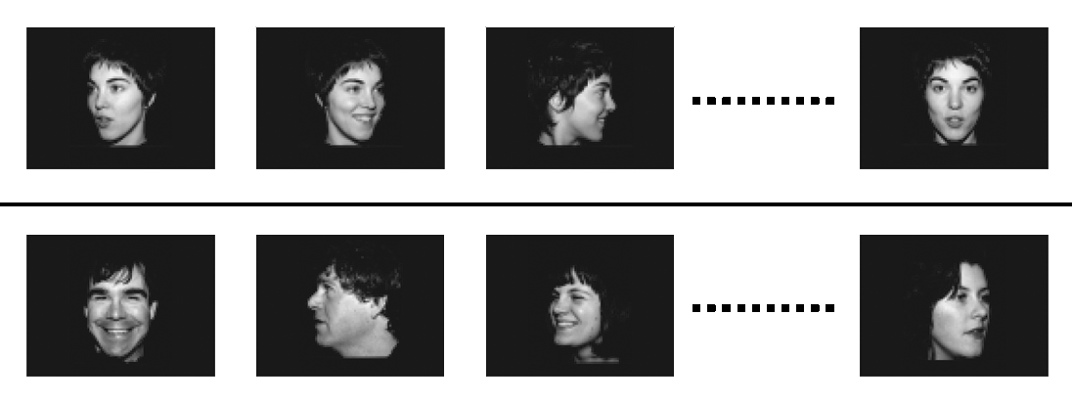
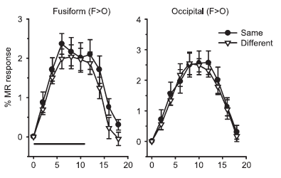
fMRI-adaptation studies
Faces
Size, position invariance; view-dependence:
Grill Spector & Malach (2001); Andrews & Ewbank (2004); Winston et al., (2004); Rotshtein et al., (2004); Fang et al., (2007); Kovacs et al., (2008).
(Andrews & Ewbank, 2004, NeuroImage)

Slide 5
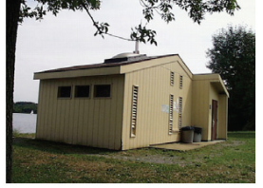
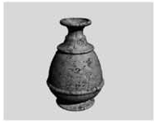
fMRI-adaptation studies
Faces
Size, position invariance; view-dependence:
Grill Spector & Malach (2001); Andrews & Ewbank (2004); Winston et al., (2004); Rotshtein et al., (2004); Fang et al., (2007); Kovacs et al., (2008).
Scenes/Places
Size, viewpoint invariant:
Epstein et al., (2003); Ewbank et al., (2005); Epstein et al., (2007)
Inanimate objects
Size, position, occlusion, view invariant:
Grill-Spector et al., (1999); Grill-Spector & Malach (2001); Kourtzi & Kanwisher (2000); Kourtzi & Kanwisher (2001); James et al., (2002); Ewbank et al., (2005).

Slide 6
Mechanisms of fMRI-adaptation
Adaptation is the consequence of locally based changes –
Neuronal fatigue - the same population of cells are repeatedly activated and fire less (see Grill-Spector et al., 2006)
‘Predictive coding’ – Adaptation is the consequence of systemic changes - reflects a decrease in prediction error between bottom-up (stimulus-related) and top-down (prediction-related) inputs
  Each level of the hierarchy ‘predicts’ representations in the level below. Increased activity reflects increased ‘prediction error’ (Friston, 2005).
  Thus, when input is more predictable (i.e. during repetition) activity in lower-level region is suppressed by higher-level region (Henson, 2003; Friston, 2005).
Distinguishing between these models is vital for the correct interpretation of fMRI-adaptation data.
1

Slide 7
Dynamic Causal Modelling (DCM)
Explains regional BOLD effects in terms of changing patterns of connectivity amongst regions.
Uses a dynamic state equation to model how neural activity in a network changes over time (Friston et al., 2003).
Enables causal inferences to be made about regional changes:
Is brain region A responsible for the change in activation of brain region B?
Where does a sensory stimulus enter a network of brain regions?
Which connections are modulated by experimental factors? (e.g. stimulus repetition)

Slide 8
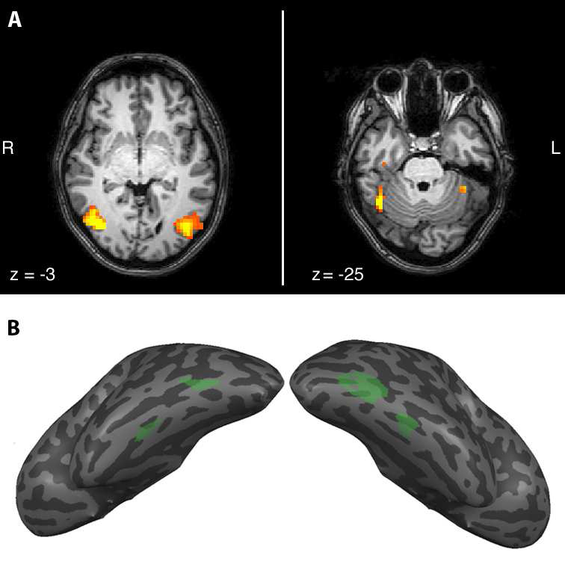
Regions responding to human bodies
EBA
FBA
EBA
FBA
Downing & Peelen (2011)
(EBA) Extrastriate Body area : Part based analysis of bodies
(FBA) Fusiform Body area: Representation of whole bodies

Slide 9
Study - fMRI-adaptation to human bodies
Aims
Measure adaptation in body-sensitive regions of the occipitotemporal cortex.
Use DCM to investigate the mechanisms underlying fMRI-adaptation in these regions.
Determine whether the same mechanisms underlie adaptation to identical images (same-size-same-view) and adaptation across changes in stimulus size and view.

Slide 10
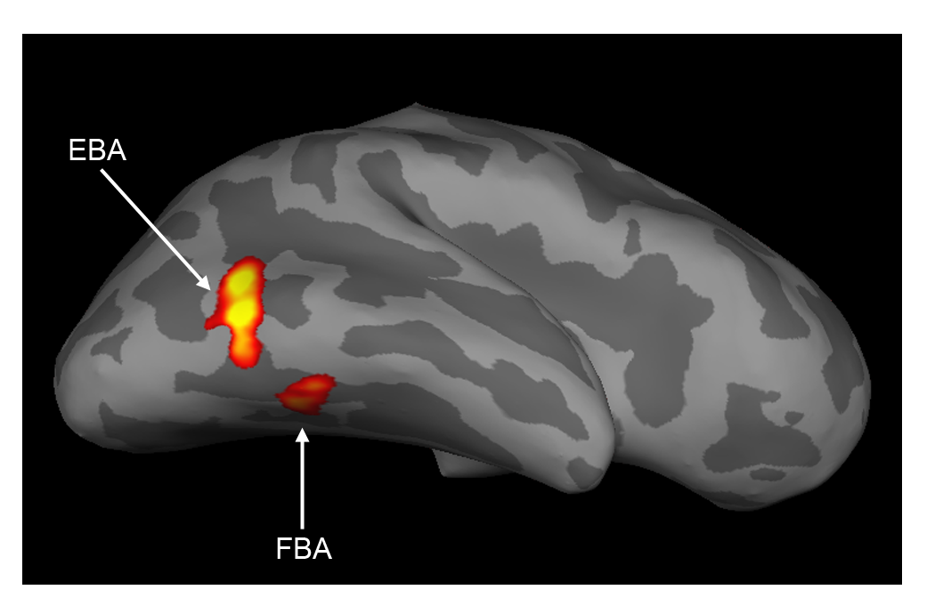

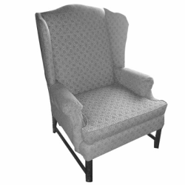
Regions responding to human bodies
Functional localiser
P < 0.05 FWE corrected
Bodies > Chairs
Ewbank et al., (2011), Journal of Neuroscience

Slide 11
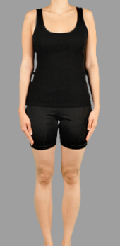

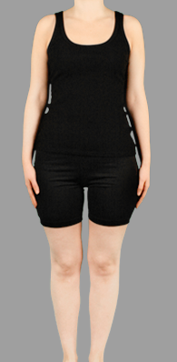
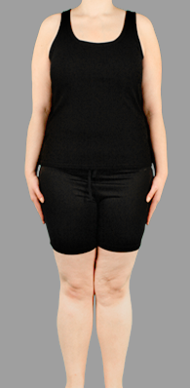
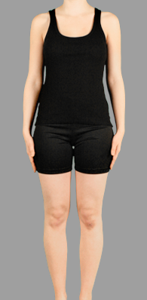
Neural representation of human bodies
Same-Size-Same-View
Same Identity
Different Identity
Ewbank et al., (2011), Journal of Neuroscience

Slide 12

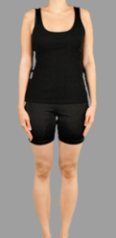

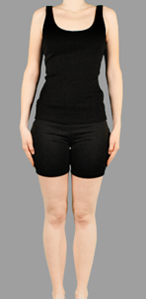

Neural representation of human bodies
Vary-Size
Same Identity
Different Identity
Ewbank et al., (2011), Journal of Neuroscience

Slide 13

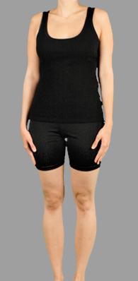

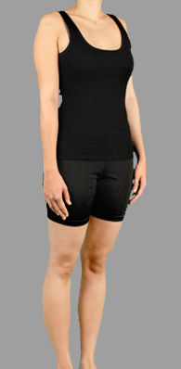
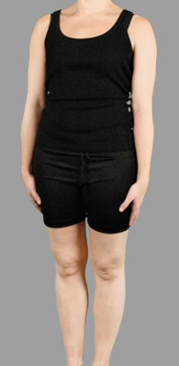
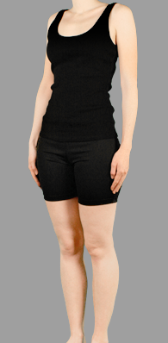
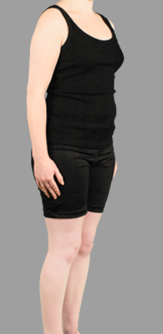
Neural representation of human bodies
Vary-View
Same Identity
Different Identity
Ewbank et al., (2011), Journal of Neuroscience

Slide 14
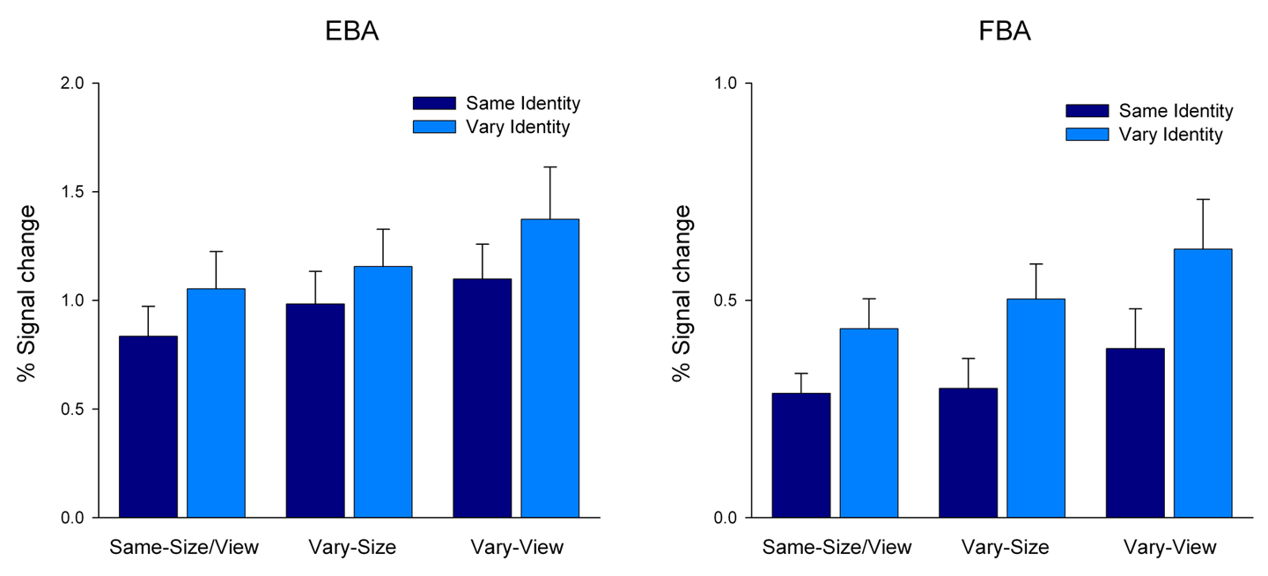
Adaptation in body-sensitive regions
Univariate analysis
Main effect of Identity (F(1,14) = 6.5, p < 0.01)
Identity x Size/View (P > 0.63)
Main effect of Identity (F(1,14) = 16.4, p < 0.005)
Identity x Size/View (P > 0.68)
No adaptation outside of body-sensitive regions (P > 0.001 uncorrected)
Adaptation to body identity in EBA and FBA is invariant to changes in size and view

Slide 15
Body adaptation – ROI analysis
What are the mechanisms underlying adaptation to bodies in EBA and FBA in each of the three conditions (same-size-same-view, vary-size, vary-view)?

Slide 16
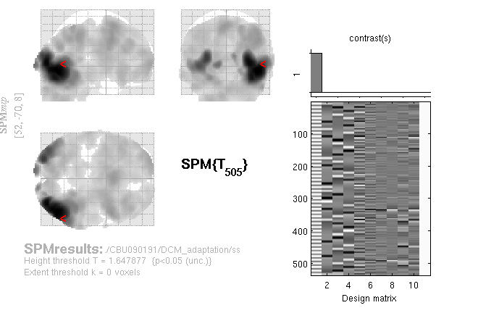
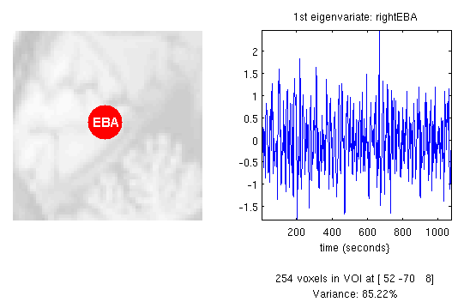
Body adaptation - DCM
Extract first eigenvariate (time course of principle source of variance) from each ROI. – Same data included in univariate and DCM analysis.
First eigenvariate weights voxels according to activation level.
Mean variance:
EBA = 88%
FBA = 78%

Slide 17
Dynamic Causal Modelling (DCM)
DCM uses a bilinear state equation, to model a cognitive system at its underlying neuronal level (not directly accessible for fMRI).
Active
regions
Fixed connections
Modulatory
inputs
External
inputs
The modelled neuronal dynamics (z) is transformed into area-specific BOLD signals (y) by a hemodynamic forward model (λ).
The aim of DCM is to estimate parameters at the neuronal level such that the modelled BOLD signals are maximally similar to the experimentally measured BOLD signals. Model selection is used to test how well the neural model fits the measured signal, compared to other models.

Slide 18
Dynamic Causal Modelling (DCM)
Input
(Bodies)
FBA
Fixed
coupling
Contextual Modulation
(Same vs. Different Identity)
Input
(Bodies)
EBA
Driving Input
Modulation
Input enters EBA
Input enters FBA
Input enters EBA/FBA
Forward connectivity (EBA to FBA)
Backward connectivity (FBA to EBA)
Forward and backward connectivity
Self-connectivity only

Slide 19
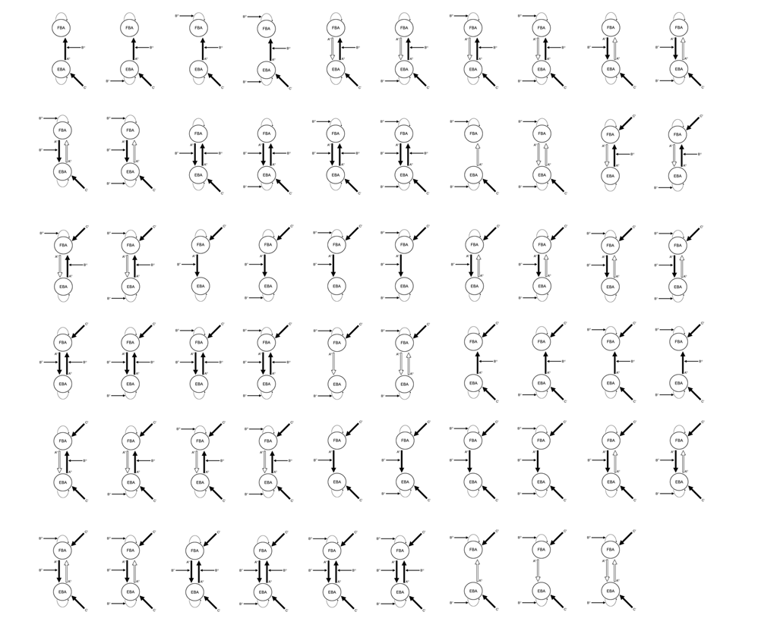
Model space
Notes:
21 models
Family A – Input enters OFA only
Family B – Input enters FFA only
Family C – Parallel inputs in OFA and FFA
RS modulates self-connectivity only (1), self and between-region connectivity (2-4), between-region connectivity only (5-7).
RS can modulate forward, backward or forward and backward connectivity.

Slide 20
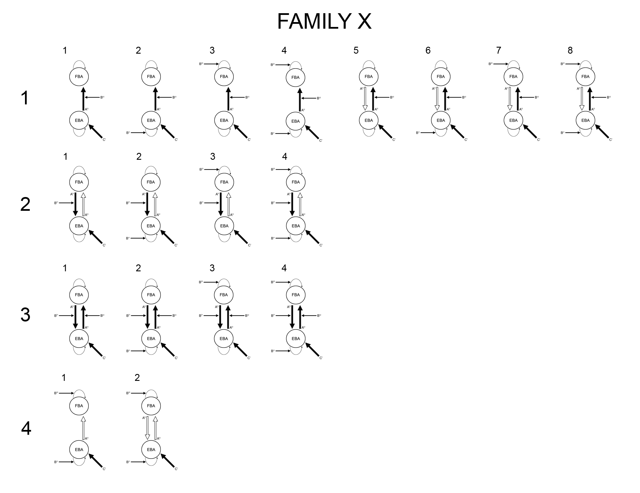
Model space
Meta Family X –
Input enters EBA only
Notes:
21 models
Family A – Input enters OFA only
Family B – Input enters FFA only
Family C – Parallel inputs in OFA and FFA
RS modulates self-connectivity only (1), self and between-region connectivity (2-4), between-region connectivity only (5-7).
RS can modulate forward, backward or forward and backward connectivity.

Slide 21
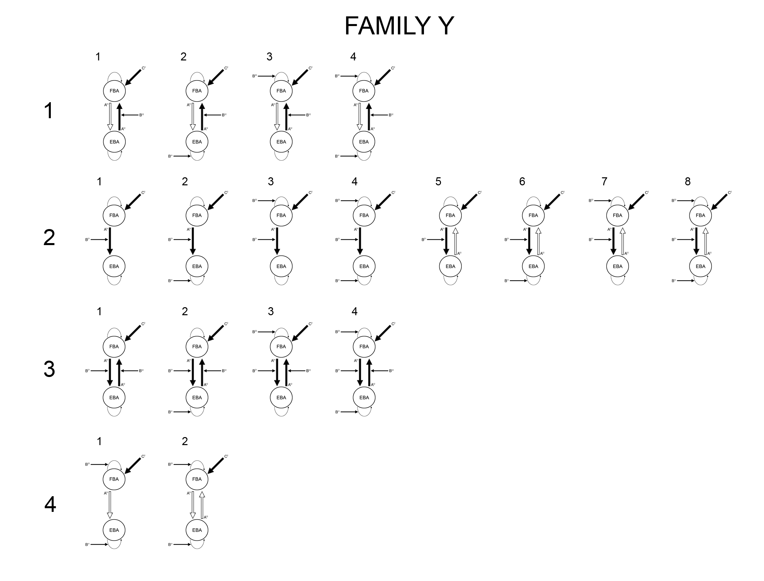
Model space
Meta Family Y –
Input enters FBA only
Notes:
21 models
Family A – Input enters OFA only
Family B – Input enters FFA only
Family C – Parallel inputs in OFA and FFA
RS modulates self-connectivity only (1), self and between-region connectivity (2-4), between-region connectivity only (5-7).
RS can modulate forward, backward or forward and backward connectivity.

Slide 22
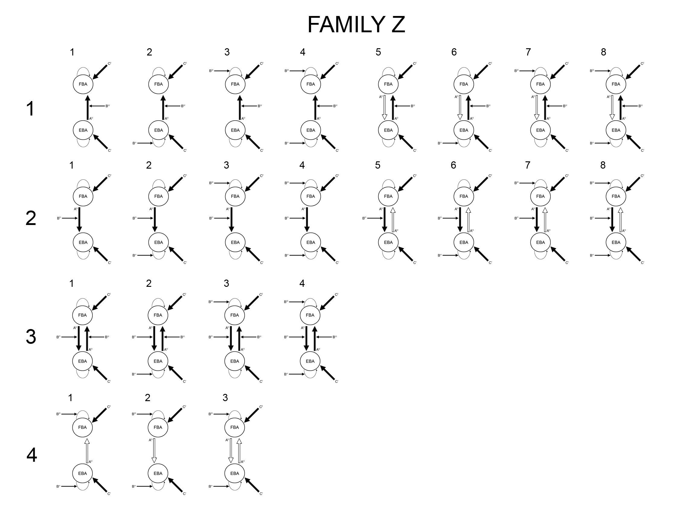
Model space
Meta Family Z –
Input enters EBA/FBA
Notes:
21 models
Family A – Input enters OFA only
Family B – Input enters FFA only
Family C – Parallel inputs in OFA and FFA
RS modulates self-connectivity only (1), self and between-region connectivity (2-4), between-region connectivity only (5-7).
RS can modulate forward, backward or forward and backward connectivity.

Slide 23
Model space
Family 1 – Changes in forward connectivity (EBA-to-FBA)
Family 2 – Changes in backward connectivity (FBA-to-EBA)
Family 3 – Changes in forward/backward connectivity
Family 4 – No change in connectivity
Notes:
21 models
Family A – Input enters OFA only
Family B – Input enters FFA only
Family C – Parallel inputs in OFA and FFA
RS modulates self-connectivity only (1), self and between-region connectivity (2-4), between-region connectivity only (5-7).
RS can modulate forward, backward or forward and backward connectivity.

Slide 24
Model space
Driving Input ‘C’
EBA
FBA
EBA FBA
X1
Y1
Z1
EBA FBA
X2
Y2
Z2
EBA FBA
Change in connectivity ‘B’
EBA FBA
X3
Y3
Z3
EBA FBA
X4
Y4
Z4
No change

Slide 25
Model selection
Bayesian Model Selection (BMS) – Fixed Effects (FFX)
Comparison of model evidence
Free energy estimates (F)
Identify most likely model
Notes:
21 models
Family A – Input enters OFA only
Family B – Input enters FFA only
Family C – Parallel inputs in OFA and FFA
RS modulates self-connectivity only (1), self and between-region connectivity (2-4), between-region connectivity only (5-7).
RS can modulate forward, backward or forward and backward connectivity.

Slide 26
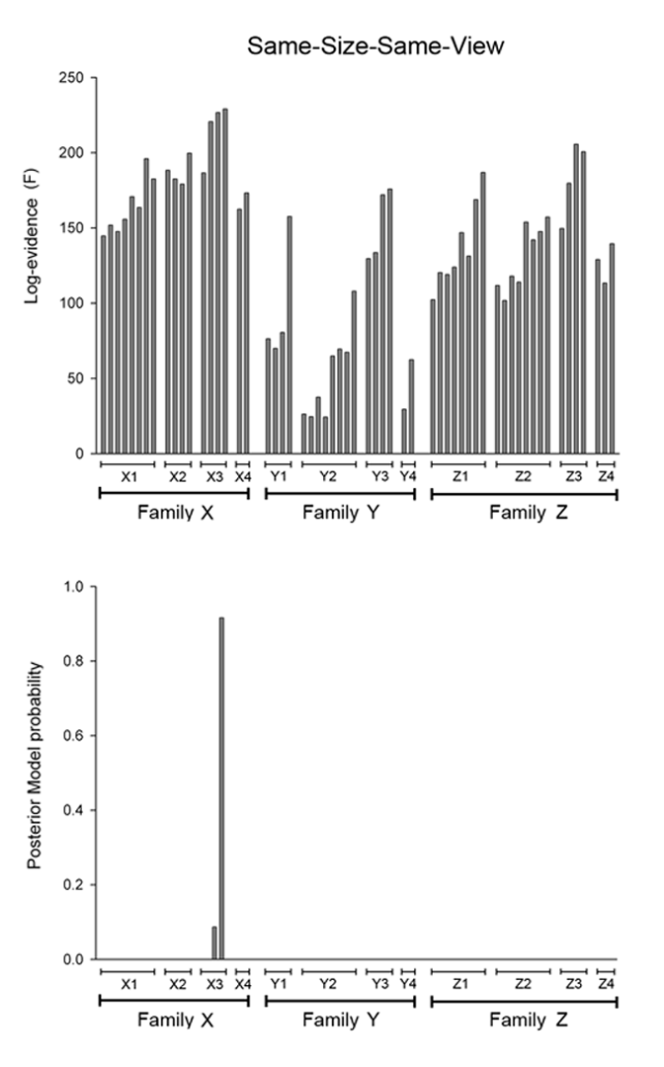
BMS – FFX – Same-Size-Same-View
Model X3⁴
Same-same-same-view
FBA
Identity
repetition
Vary-size
Likelihood that model
generated data
EBA
Family X3 (p = .99)
Input
∆F > 3 “strong evidence”

Slide 27
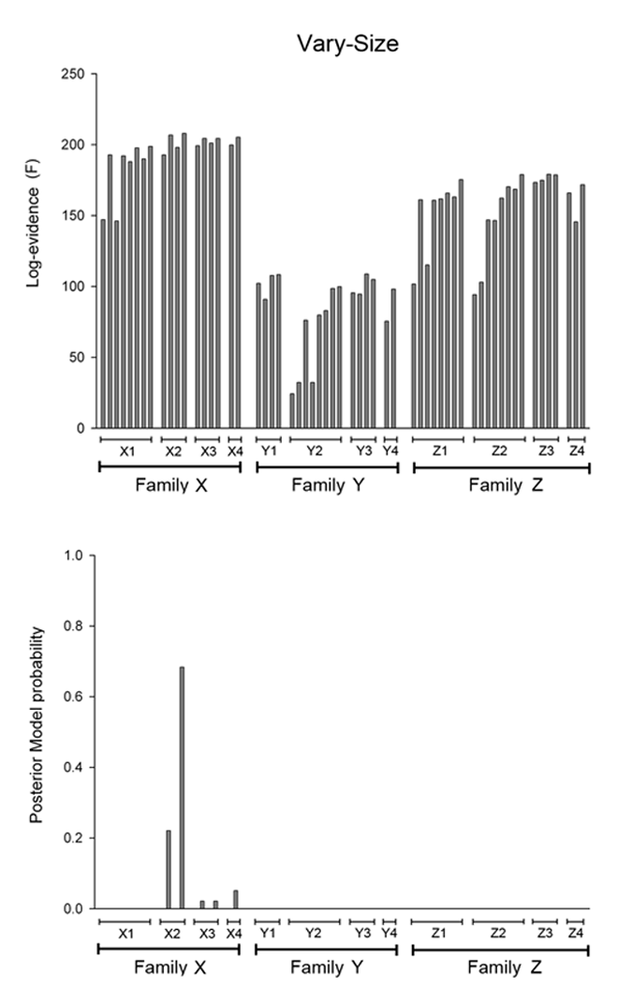
BMS – FFX – Vary-Size
Model X2⁴
Same-same-same-view
FBA
Identity
repetition
Vary-size
EBA
Family X2 (p = .90)
Input
∆F > 1 “positive evidence”

Slide 28
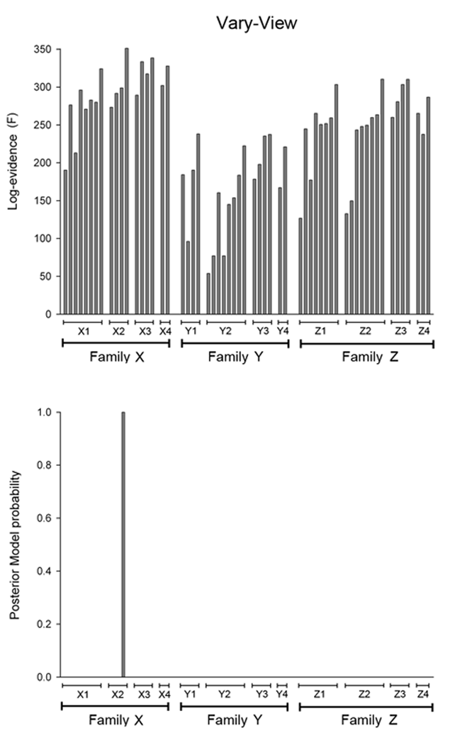
BMS – FFX – Vary-View
Model X2⁴
Same-same-same-view
FBA
Identity
repetition
Vary-size
EBA
Family X2 (p = 1.0)
Input
∆F > 5 “very strong evidence”

Slide 29
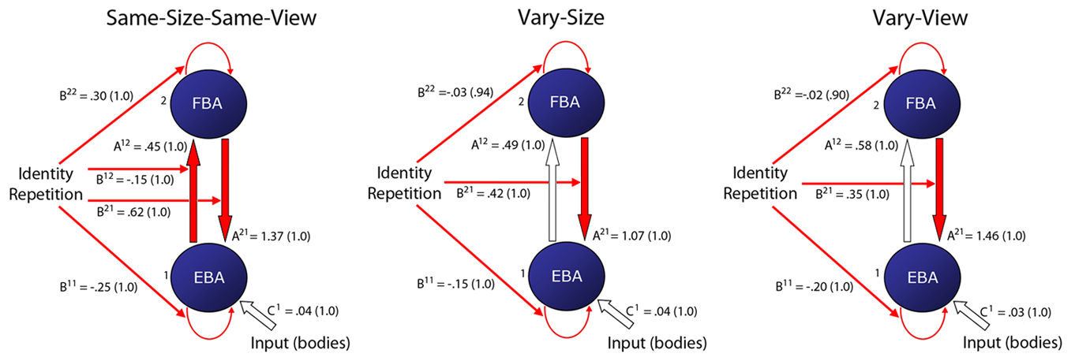
DCM model selection
Ewbank et al., (2011), Journal of Neuroscience

Slide 30
Model selection
FFX analysis is susceptible to outliers in model evidence – (Sum of model evidence over subjects).
RFX analysis incorporates between subject differences – not all subjects generated their data according to the same model.
RFX reports the extent to which each model is more likely than any other model to have generated the data (Sums to 1).
Including multiple models (n = 59) with shared features means that one model is less likely to dominate.
Notes:
21 models
Family A – Input enters OFA only
Family B – Input enters FFA only
Family C – Parallel inputs in OFA and FFA
RS modulates self-connectivity only (1), self and between-region connectivity (2-4), between-region connectivity only (5-7).
RS can modulate forward, backward or forward and backward connectivity.

Slide 31
Model selection
Bayesian Model Selection (BMS) – Random Effects (RFX)
Comparison of model families
Comparison within winning family
Identify most likely model
Notes:
21 models
Family A – Input enters OFA only
Family B – Input enters FFA only
Family C – Parallel inputs in OFA and FFA
RS modulates self-connectivity only (1), self and between-region connectivity (2-4), between-region connectivity only (5-7).
RS can modulate forward, backward or forward and backward connectivity.

Slide 32
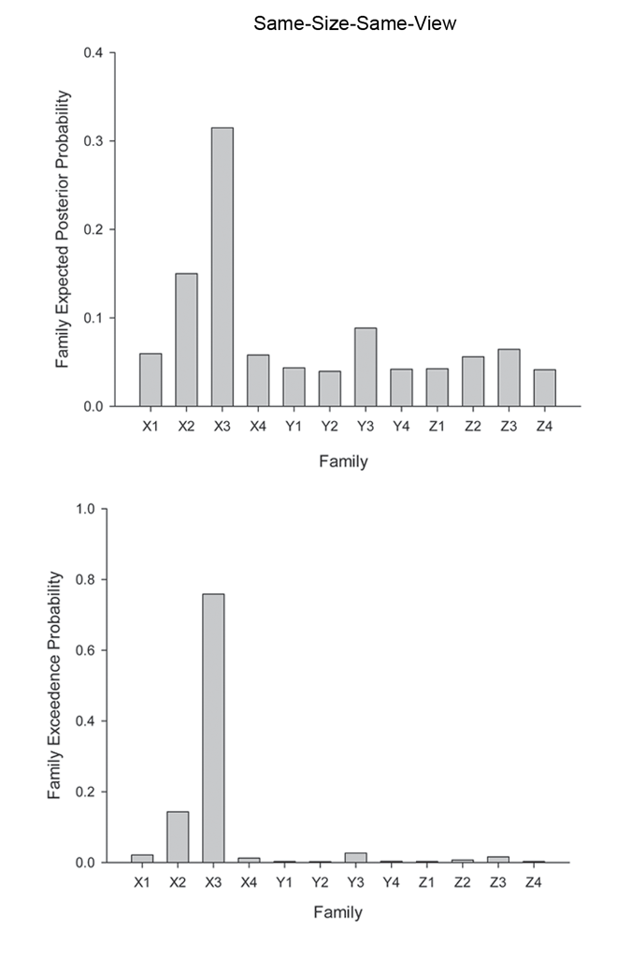
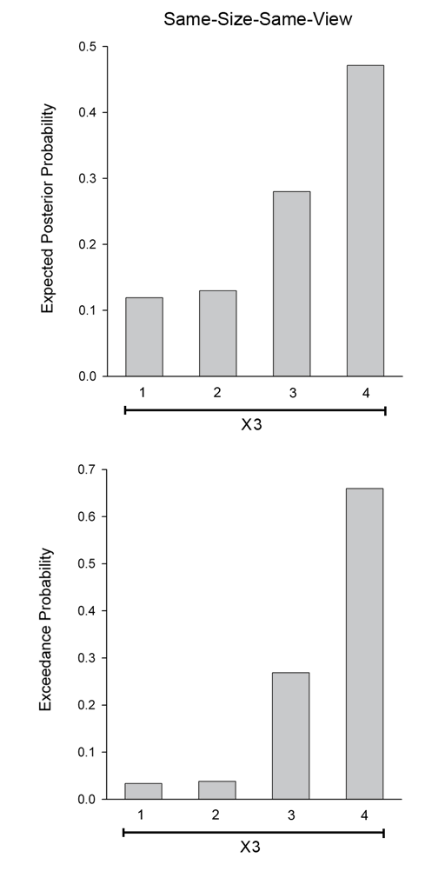
BMS – RFX – Same-Size-Same-View
Same-same-same-view
Vary-view
Probability of model
generating observed data
Vary-size
Belief that each
model is more likely
than any other model

Slide 33
BMS – RFX – Same-Size-Same-View
Model X3⁴
FBA
Identity
repetition
EBA
Input

Slide 34
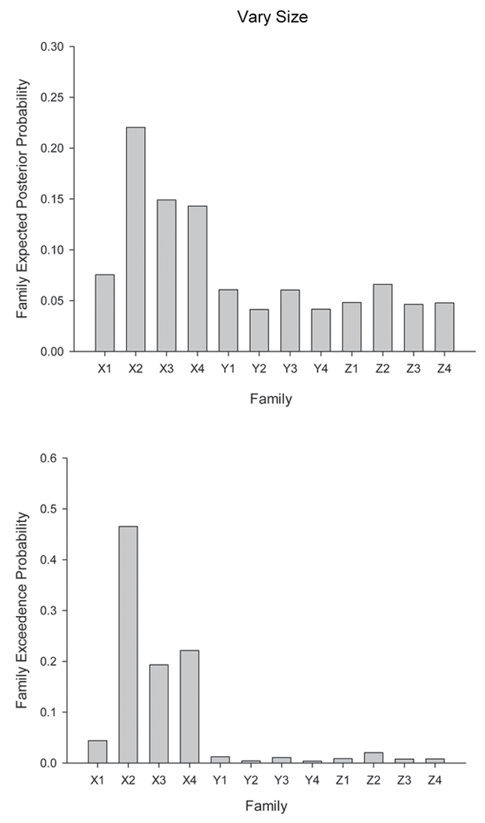
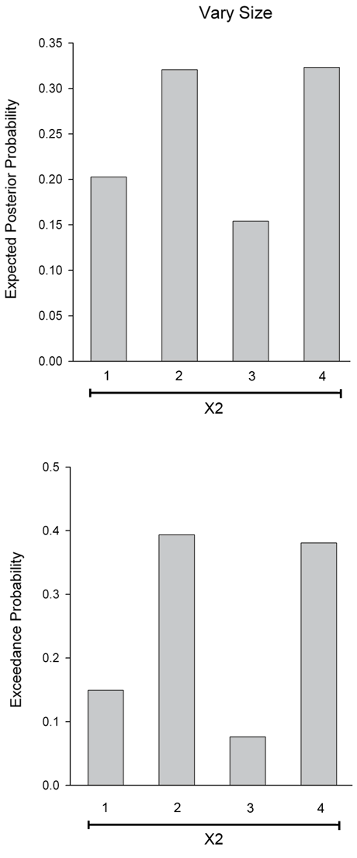
BMS – RFX – Vary-Size
Same-same-same-view
Vary-view
Vary-size

Slide 35
BMS – RFX – Vary-Size
Model X2²
Model X2⁴
Same-same-same-view
Vary-view
FBA
FBA
Identity
repetition
Identity
repetition
Vary-size
EBA
EBA
Input
Input

Slide 36
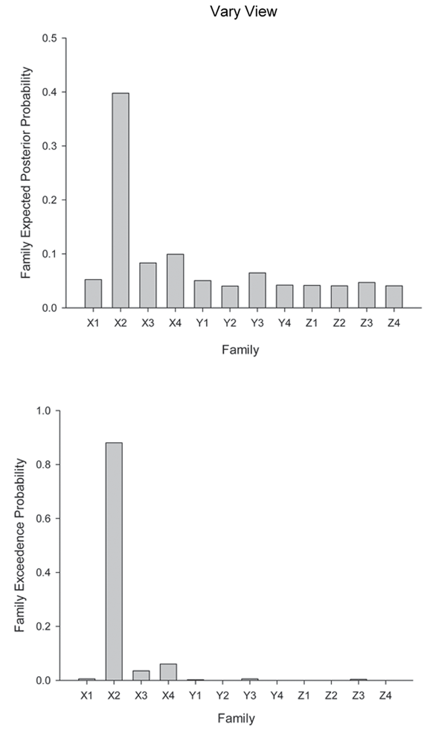
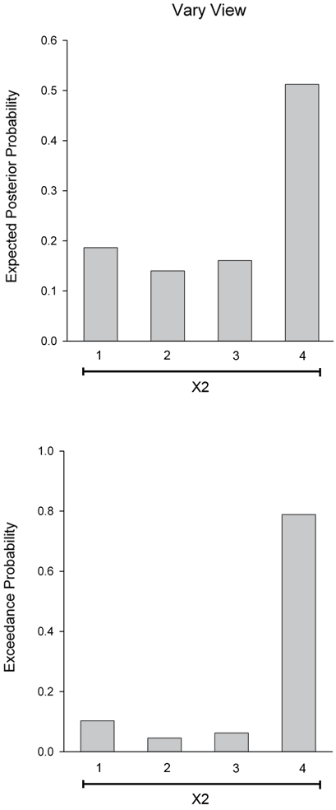
BMS – RFX – Vary-View
Vary-view
Vary-size

Slide 37
BMS – RFX – Vary-View
Model X2⁴
Vary-view
FBA
Identity
repetition
EBA
Input

Slide 38
Mechanisms of fMRI-adaptation – Summary
Univariate analysis reveals adaptation in EBA and FBA is invariant to changes in image size and view.
DCM reveals different mechanisms underlie the different forms of adaptation.
Adaptation (across size/view) is associated with a change in backward (FBA-to-EBA) connectivity only.
Repetition of identical images (same-size-same-view) is associated with changes in forward connectivity (EBA-to- FBA) .
Concordance between FFX and RFX approaches in model selection.

Slide 39
Mechanisms of fMRI-adaptation – Summary 2
MEG/ERP evidence - adaptation to identical images around 160ms (Schendan and Kutas, 2003; Ewbank et al., 2008) - “First Pass”.
Adaptation across view approx 400ms (Schendan and Kutas, 2003) – “Feedback”.
‘Top-down’ modulation (changes in backward FFA-to-OFA connectivity) underlies fMRI-adaptation to faces (across size).
Adaptation to the same image produces changes in forward connectivity.

Slide 40

Mechanisms of fMRI-adaptation – (Same-Size/View)
Identity A – Same-Size-Same-View
A¹
A¹
A¹
B¹
A²
A
A¹
B
B²
A³
B³
C²
C
C³
C¹
EBA
FBA
Notes:
In the same-size condition RS is characterised by changes in ‘forward’ connectivity between OFA and FFA.
In the vary-size condition RS is characterised by changes in ‘backward’ connectivity between OFA and FFA.

Slide 41
Mechanisms of fMRI-adaptation – (Same-Size/View)
Identity A – Same-Size-Same-View
A¹
A¹
A¹
B¹
A²
A
A¹
B
B²
A³
B³
C²
C
C³
C¹
EBA
FBA
Notes:
In the same-size condition RS is characterised by changes in ‘forward’ connectivity between OFA and FFA.
In the vary-size condition RS is characterised by changes in ‘backward’ connectivity between OFA and FFA.

Slide 42


Mechanisms of fMRI-adaptation – (Vary-View)
Identity A – Same-Size-Same-View
A¹
A²
A³
B¹
A²
A
A¹
B
B²
A³
B³
C²
C
C³
C¹
EBA
FBA
Notes:
In the same-size condition RS is characterised by changes in ‘forward’ connectivity between OFA and FFA.
In the vary-size condition RS is characterised by changes in ‘backward’ connectivity between OFA and FFA.

Slide 43
Mechanisms of fMRI-adaptation – (Vary-View)
Identity A – Same-Size-Same-View
A¹
A²
A³
B¹
A²
A
A¹
B
B²
A³
B³
C²
C
C³
C¹
EBA
FBA
Notes:
In the same-size condition RS is characterised by changes in ‘forward’ connectivity between OFA and FFA.
In the vary-size condition RS is characterised by changes in ‘backward’ connectivity between OFA and FFA.

Slide 44
Mechanisms of fMRI-adaptation – Conclusion
Not all adaptation effects are created equal.
Relative contribution of bottom-up and top-down mechanisms depend on the precise conditions (i.e. same stimulus, changes in stimulus size/view).
Size- and view-invariant adaptation in EBA appears to be the consequence of modulation from FBA.
Adaptation in EBA is not necessarily indicative of a size and view-invariant neuronal population within EBA.
Adaptation is not “localised” to one region but reflects changes at a network level.

Slide 45
Acknowledgements:
Andy Calder
Rik Henson
James Rowe
Rebecca Lawson
Luca Passamonti

