Slide 1

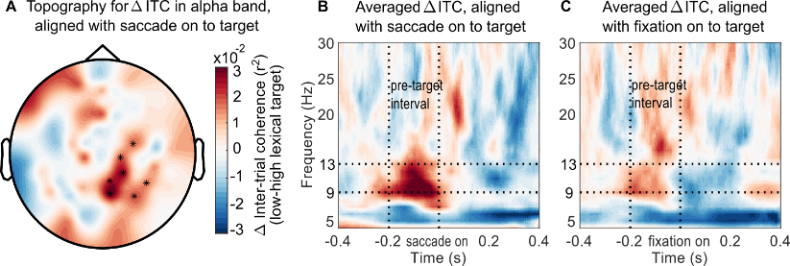
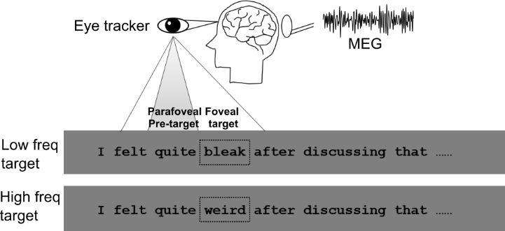
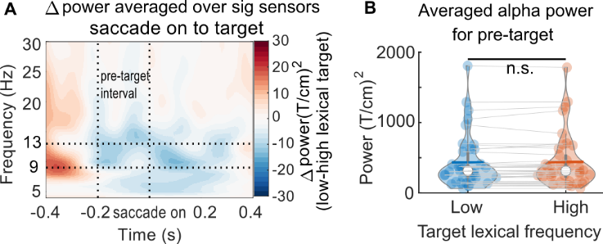
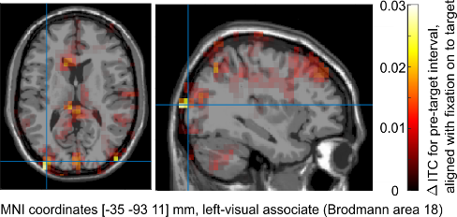
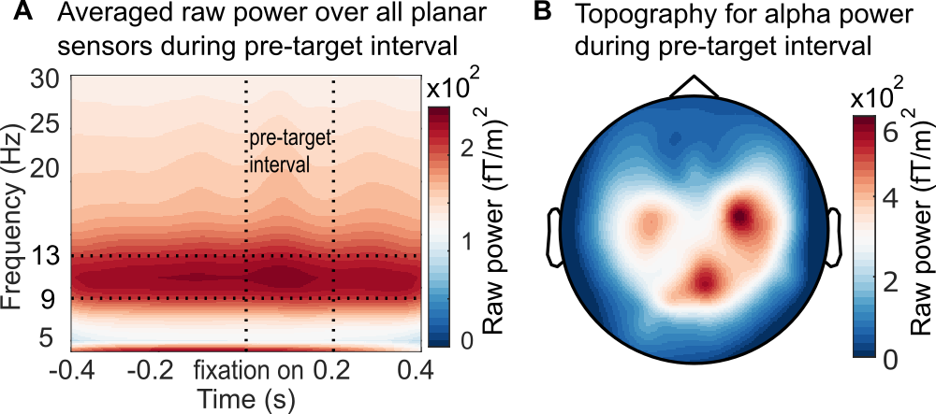
Saccades are locked to the phase of alpha activity during natural reading
Yali Pan^{1,2*,} Tzvetan Popov³, Steven Frisson^{1,2}, Ole Jensen^{1,2}
¹Centre for Human Brain Health, ²School of Psychology, University of Birmingham, Birmingham , United Kingdom; ³ Methods of Plasticity Research, Department of Psychology, University of Zurich, Zurich, Switzerland. *Correspondence: y.pan.1@bham.ac.uk;
Introduction
Stronger phase-locking in the alpha band prior to saccading to the word with lower frequency
How to coordinate saccades during natural reading?
We make 3~5 saccades per second to extract meaning from text during reading [1].
Saccades can modulate neuronal excitability in the visual cortex [2,3], and micro-saccades were shown to reset the phase of ongoing oscillation [4].
Saccades locked to the phase of alpha activity predict memory encoding [5].
?
We here ask if saccades are locked to the alpha phase during reading? Is this phase- locking modulated by word properties, e.g., word frequency?
We calculated inter-trial coherence (ITC) in the alpha band (9 – 13 Hz) for pre-target interval (-0.2- 0 s), aligned with the saccade onset to target word.
Panel A showed the significant cluster of sensors that had higher ITC in the alpha band when pre-processing the target with low word frequency compared to high word frequency (n=38, P_{cluster} < 0.05, shuffle 5000 times).
Panel B showed the averaged ITC difference over this sensor cluster.
Panel C indicates that this phase-locking in alpha band is specific to the saccade onset. We did the same analysis for pre-target interval but aligned with fixation onset to target word. No significant difference was found.
The free reading paradigm
Participant | 39 native British English speakers (25 females), aged 22 ± 2.6 (mean ± SD), right-handed, with normal or corrected-to-normal vision, without any language disorder diagnosis. One participant was excluded due to few trials, which left 38 participants (n=38).
Task | A silent reading task. 25% of the sentences were followed by a yes-or-no comprehension question to ensure careful reading.
Material | 228 sentences, all plausible with unpredictable targets of either low or high word frequency. Each target pair has same word length.
Measurements | An eye-tracker and MEG were used to record eye movements and brain activity simultaneously.
(It is the same dataset as in ‘’Neural evidence for lexical parafoveal processing’’ [6])
The alpha ITC difference is not driven by power magnitude. We estimated the power difference for the per-target interval (-0.2 – 0 s), aligned with saccade onset to target word, as shown in panel A. But no significant difference was found in the alpha power as shown in panel B (n=38, p=0.24, two-sided pairwise t-test). Therefore, saccades reset the phase of the ongoing alpha activity without affecting its power.
The alpha ITC effect originates from the visual cortex
We localized the ITC difference in pre-target interval to the early visual cortex (BA 18) using a beamformer technique (LCMV).
(sensor level result was shown as a topo in panel A above).
Alpha activity prevails during natural reading
Conclusions
Saccade onsets are locked to alpha phase (but not fixations). This indicates that the ocular system collaborates with the visual system during reading.
Stronger phase-locking helps to better prepare the visual cortex for more difficult incoming words.
Alpha phase acts as a precise temporal sampling framework during reading.
We extracted 1s epochs, aligned with fixation on to the pre-target word. The averaged fixation duration for pre-target is 0.2 s. Raw power was estimated from 4 to 30Hz using Hilbert transformation,with a step of 1 Hz.
Panel A showed the averaged raw power over all valid planar sensors, where the dominant power was in the alpha band (9 - 13 Hz). Panel B showed that the raw alpha power during the pre-target interval (0 - 0.2 s; planar gradients) is mainly concentrated in the visual and parietal cortex.
References
Schotter, E. R., Angele, B. & Rayner, K. Atten Percept Psychophys. 74, 5–35 (2012).
Ito, J., et. al. Cereb. Cortex. 21(11), 2482-97 (2011)
Rajkai, C., et. al. Cereb. Cortex. 18(1), 200-209 (2008).
Bosman, A. A., et. al. J. Neurosci. 29(30), 9471-80 (2009).
Staudigl, T., et. al. PLoS Biol. 15(12), 1-15 (2017).
Pan, Y., Frisson, S., Jensen, O. Nat. Commun. 12, 1-9 (2021).

