Slide 1
5. Analysis of Variance
(Balanced Multifactorial)
Between Subjects Designs
Single Subject Studies
Peter Watson

Slide 2
Randomisation experiment
Suppose wish to compare 2 teaching methods (e.g. group/individual learning ) such that each child is taught to read on their own or in a group;
2 groups of size 10 - “average ability” ; “below average ability”
To remove allocation bias
Throw a die:
In each group of 20 children allocate sets of four subjects to a method (A or B) based on number rolled: throw die five times
AABB ABAB ABBA BBAA BABA BAAB (permutation blocks)
roll a: (‘1’) (‘2’) (‘3’) (‘4’) (‘5’) (‘6’)
(could also use a minimisation approach to balance e.g. MinimPy)

Slide 3
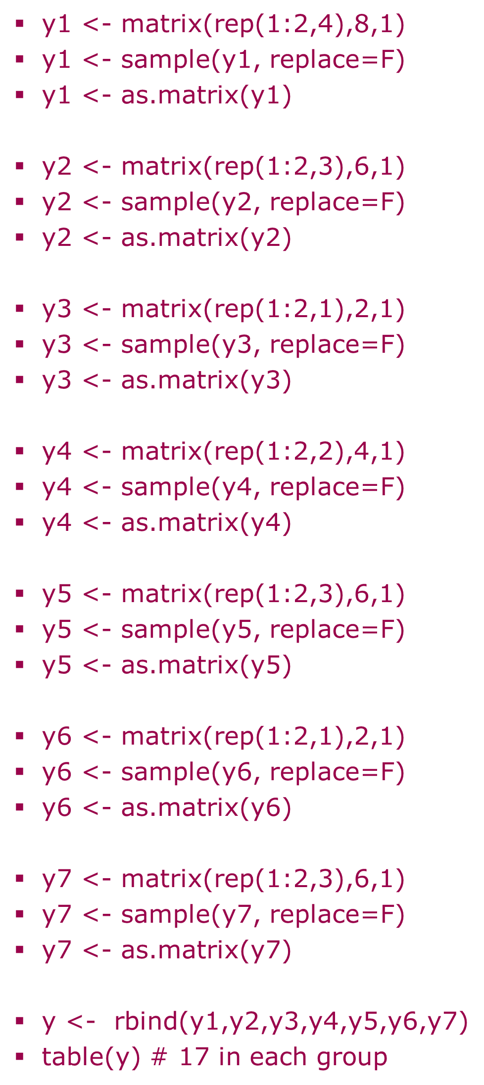
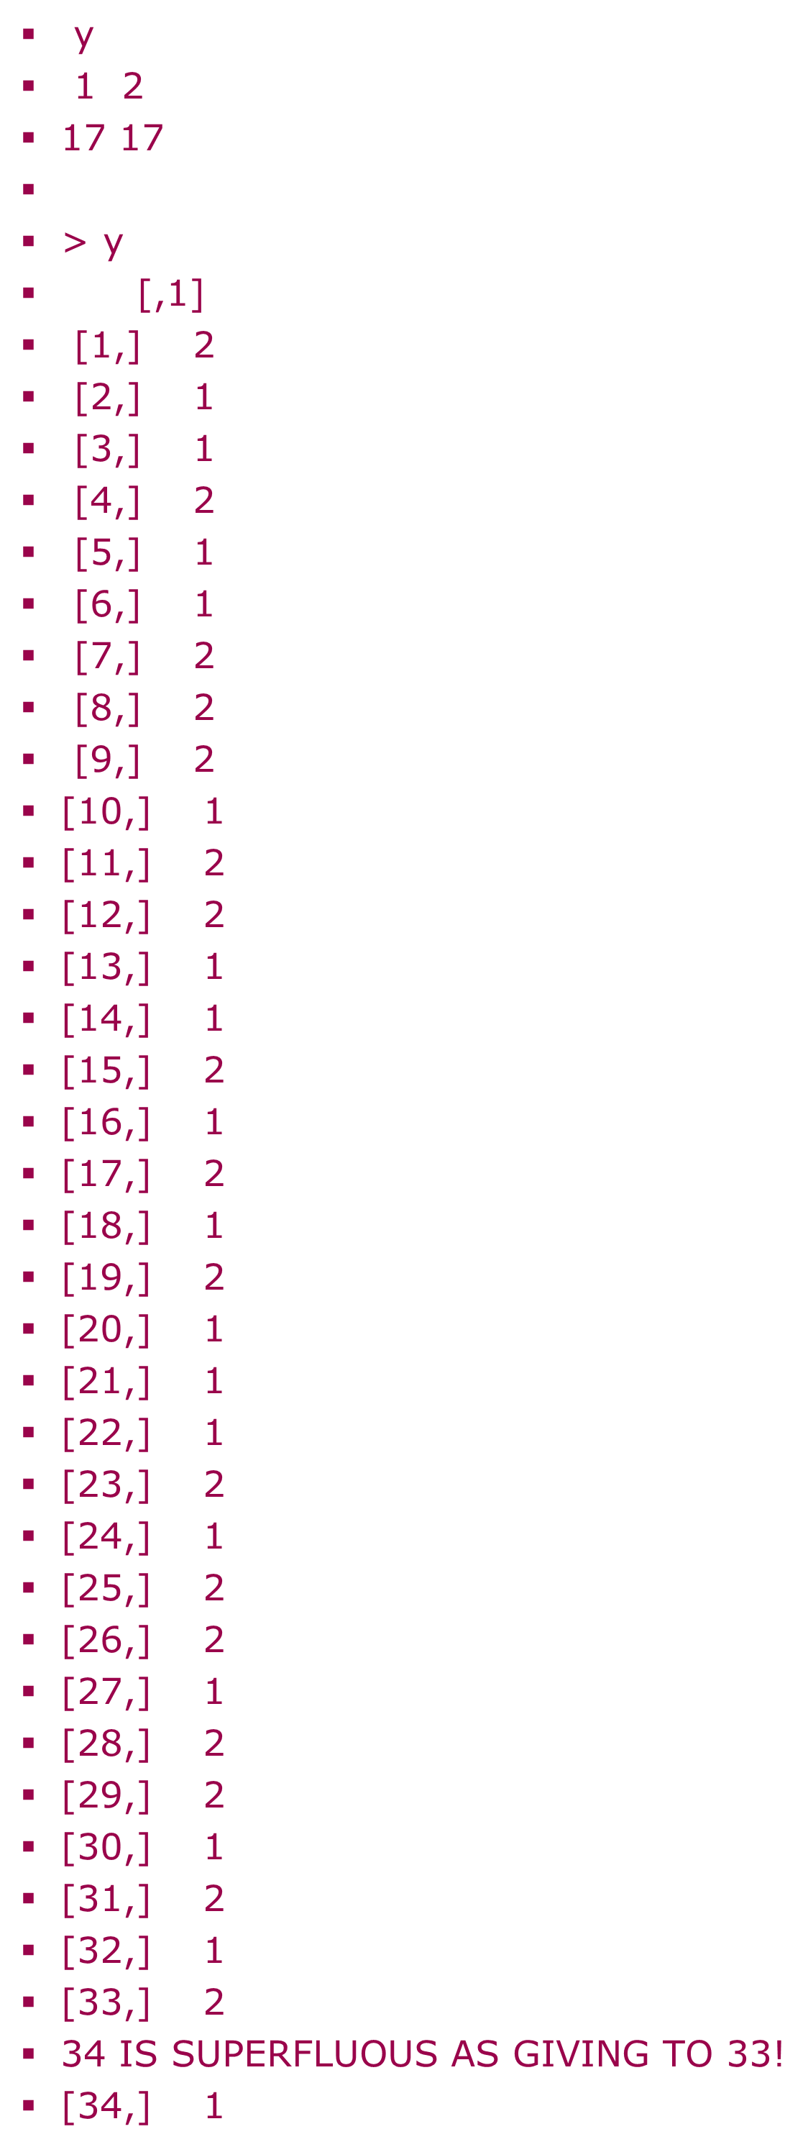
Randomised block allocation (MAPLES of Kusec et al. 2020,2023)
R syntax
Output: can be sent to an EXCEL file or for group allocation into envelopes

Slide 4
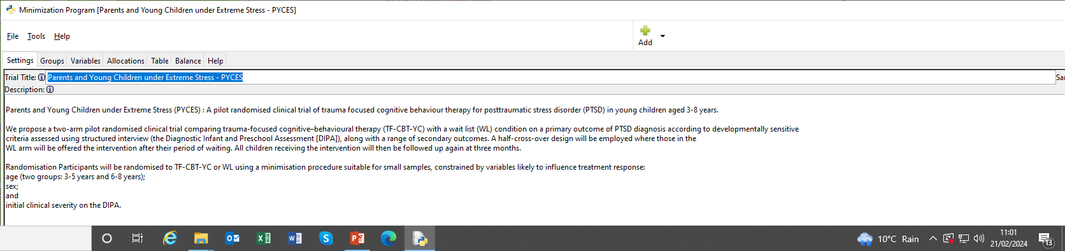
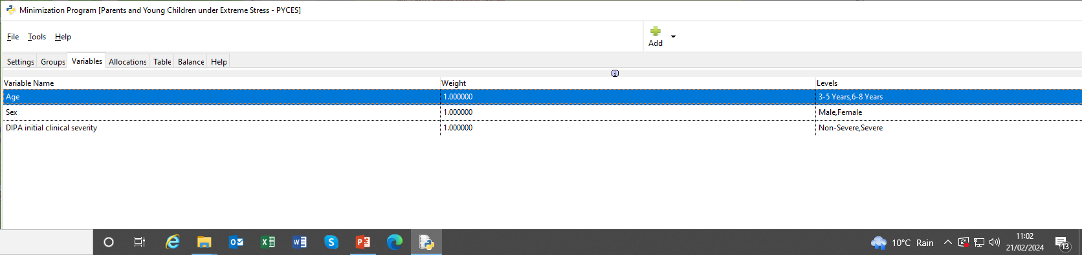
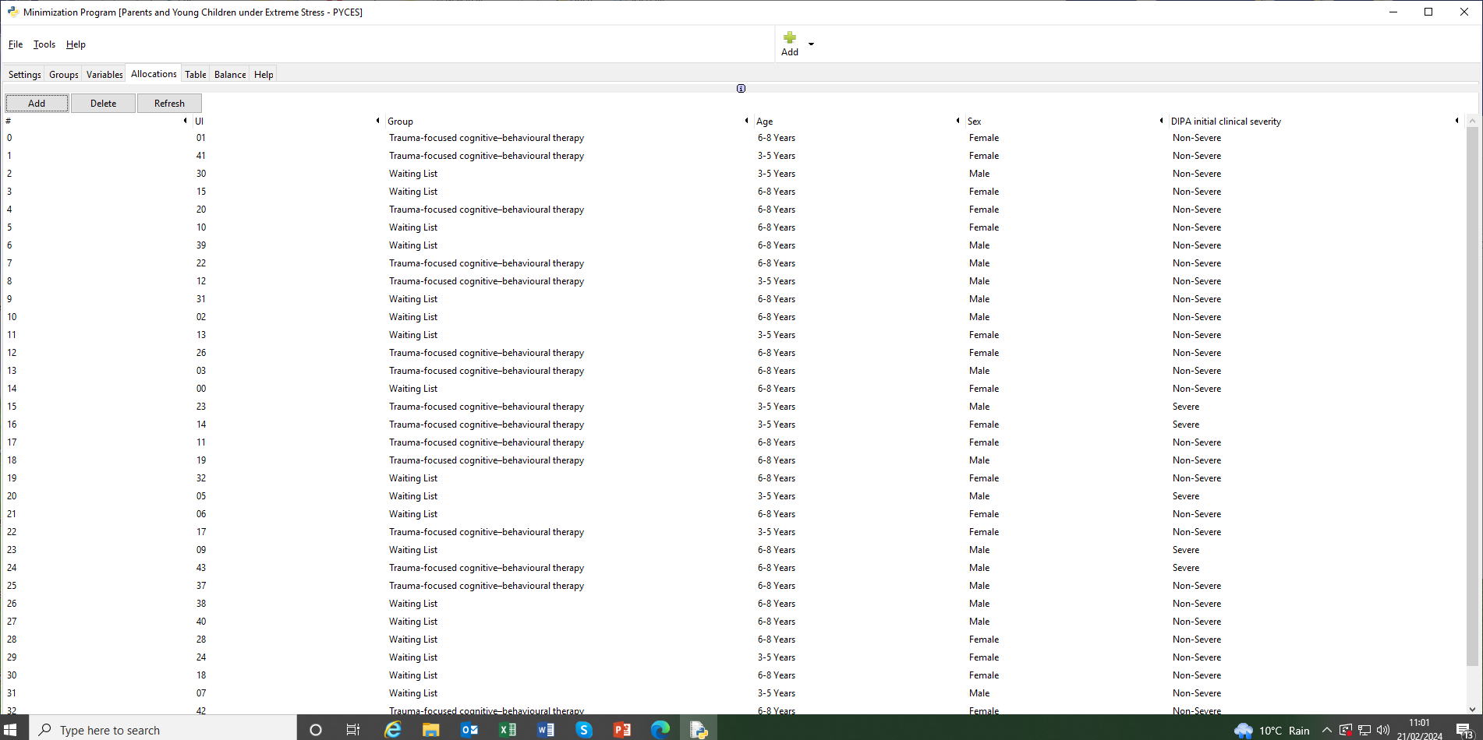
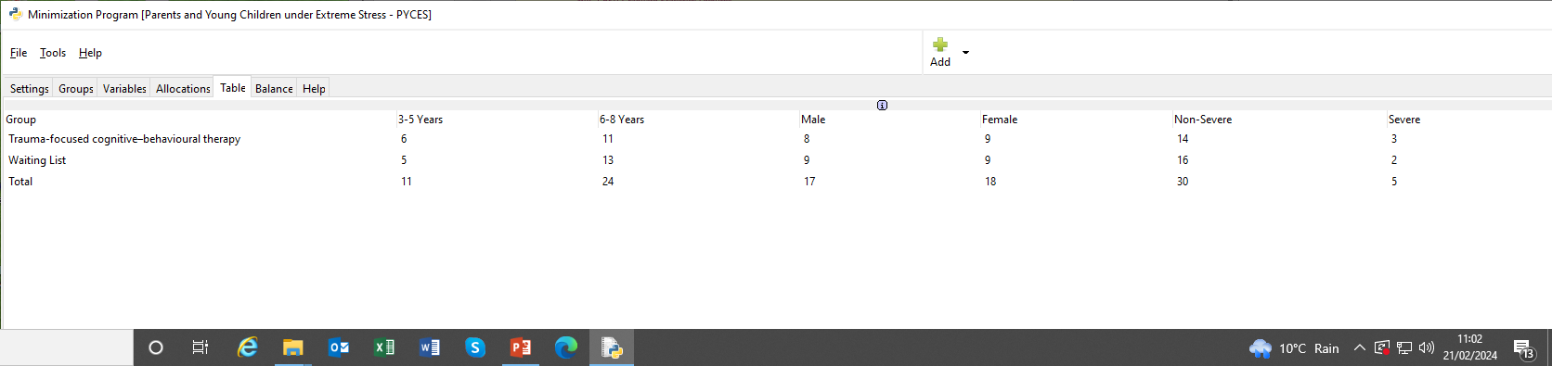
Minimpy Hitchcock et al. (2022)

Slide 5
Results:
library(plyr)
ddply(y,.(group),summarise,mean=mean(score),sd=sd(score))
10 schoolchildren form each ability randomly allocated to one of the two methods
Mean Reading scores:
Group
Method Average Below Average Mean
Individual 1.7 4.5 3.10
Group 5.5 5.6 5.55
Mean 3.60 5.05 4.375

Slide 6
Questions of interest
Compare Teaching styles
  Individual mean - Group mean
Compare Group performance
  Average mean - Below Average mean
Does teaching style success depend on the ability of the child?
  (Individual mean - Group mean) in average -
  (Individual mean - Group mean) in below average

Slide 7
One tailed testing
Use t(18) for apriori directional
hypotheses called one-tailed tests
e.g. Is individual teaching more beneficial than group learning
2 groups case only
A t test is a directional test because it takes both positive and negative values
t_{df *} t_{df} = F(1, df)
P(>1.73)=0.05
P(<-1.73)=0.05
-3 -2 -1 0 1 2
Difference in method means

Slide 8
Study types
Between subjects (this talk)
  One source of variation
  Each person has one outcome
  Random allocation of subjects
  Or study consists of a single person with multiple outcomes
Within subjects (Repeated measures)
  > 1 source of variation
  Each person has multiple outcomes

Slide 9
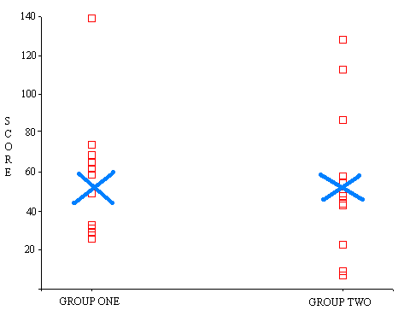
Comparing Within & between group VARIATION
Is the variation between scores only attributable to random variation between the people those scores were measured on?

Slide 10
Another example
3 groups: 2 are patient groups (severe and mild); one is a control group
Each person in a group is randomly given one of 4 word naming tasks: five people in each group do each task
How many X. can you name beginning with s?
X is animals (Task 1) or household objects (Task 2) or plants (Task 3) or countries (Task 4)

Slide 11
Task main effect
Task 2 has lower mean than task 4
(Error bar length = 95% CI)
Can plot using bar plots in SPSS or using EXCEL
(see CBSU website for details)
DEMO: PLOTS.SPS
Animals objects plants countries

Slide 12
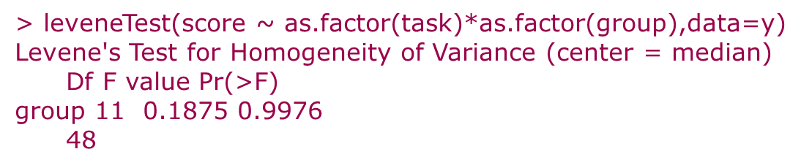
Equality of task variance assumption: Levene’s test
12 task-group pairs have equal variances
If group variances differ but normal distributions in group use Welch’s df adjustment
https://statisticsbyjim.com/anova/welchs-anova-compared-to-classic-one-way-anova/
See also Delacre, M., Lakens, D., & Leys, C. (2017).
Why Psychologists Should by Default Use Welch’s t-test Instead of Student’s t-test.
International Review of Social Psychology, 30(1), 92–101.

Slide 13
Group by Task interaction
Animals objects plants countries

Slide 14
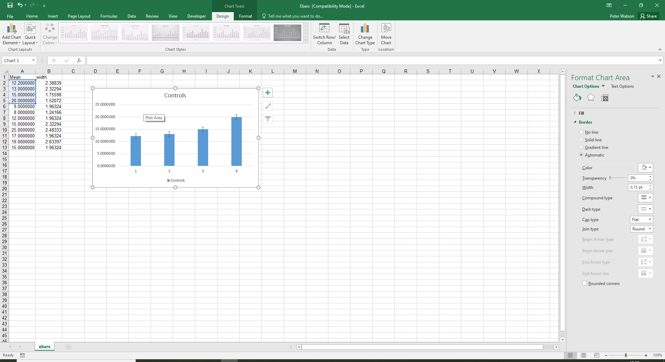
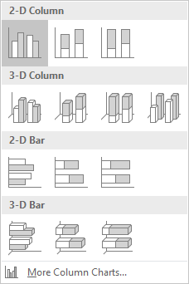
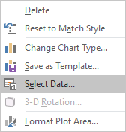
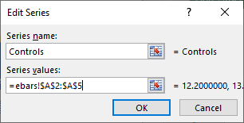

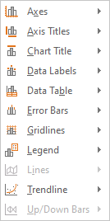
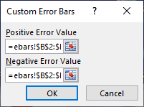
Interaction plots (means and error bars) in Excel

Slide 15
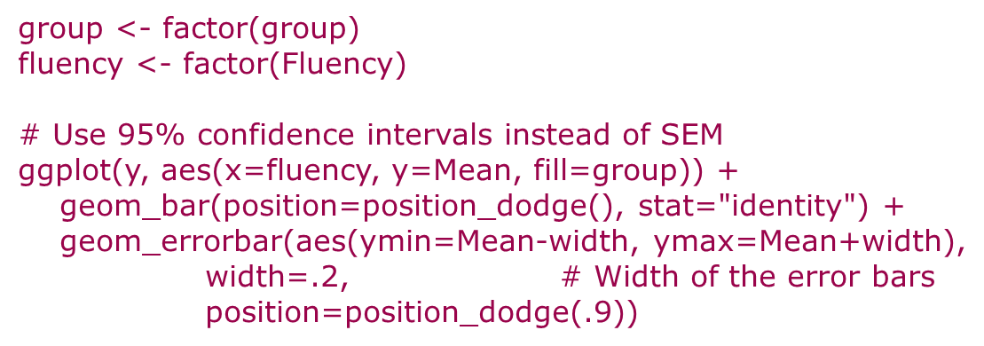
Interaction plot in R

Slide 16
Task-group scores follow a Normal distribution (randomness)
plot(regout$fitted.values,regout$residuals)

Slide 17
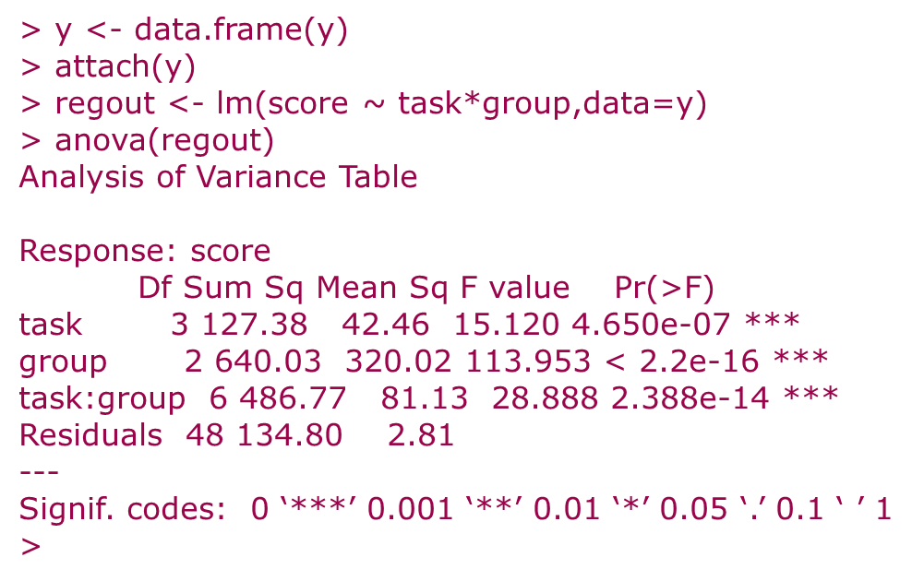
ANOVA table
Note: Anova(regout) in car library gives same result as groups are balanced but anova uses sequential SS so different in general
Interaction
Only one error term

Slide 18
Balance
Random allocation usually has equal numbers of factor combinations (balance)
e.g. task/group example we have just looked at is a balanced design
five people in each group perform each task (5 people x 4 tasks x 3 groups = 60 observations)
Balance meant task and group were statistically independent
Observational studies/surveys have unequal numbers in cells (unbalanced)
(spreadsheet:http://imaging.mrc-cbu.cam.ac.uk/statswiki/FAQ/ss)

Slide 19
Profile plot
Controls find naming animals relatively easy compared to patient groups
Controls find naming countries relatively difficult compared to patient groups
Crossed interaction
Animals Objects Plants Countries

Slide 20
Simple effects
Help explain an interaction
Howell (1997) suggests using the Error term from the analysis using all subjects
e.g. Using only Group 1 observations :
Simple effect of Task on Group 1
MS(Task) = 61.38, MS(error)=2.81 (all 4 tasks)
F(3,48) = 61.38/2.81 = 21.84, p<0.001

Slide 21
Alternatively : Simple effect of group on animals
Groups 1 & 2 = Patients;
Group 3 = Controls
Mild Severe Controls

Slide 22
Interactions
Represent the difference in simple effects
Compare either:
  simple effects of tasks
  simple effects of group

Slide 23
Size of effect
Express Sums of Squares as % Total Sum of squares
Task : 127/1389=9% (small effect according to Cohen, 1988)
Group: 640/1389=46% (large effect according to Cohen, 1988)
Task x group: 487/1389=35%
(large effect according to Cohen, 1988)
These are squared correlations (R²); Their square root is the semi-partial (also called part) correlation
Can compare R-squareds from different data sets: http://imaging.mrc-cbu.cam.ac.uk/statswiki/FAQ/rsqdiff

Slide 24
ANOVA summary
Interaction : Task by Group: F(6,48)=28.89, p<0.001
Main Effects: Task: F(3,48)=15.12, p<0.001
Group: F(2,48)=113.95, p<0.001

Slide 25
Main, Simple, interaction means
Animals Objects Plants Countries
Mild
Severe
Controls

Slide 26
Effects in a 2 Factor design
Which Group
Type of Task
Main effect
of
Main effect
of
Interaction between
SIMPLE EFFECT of
@group=control
@group=mild
SIMPLE EFFECT of
@task=naming animals
@task=naming countries

Slide 27
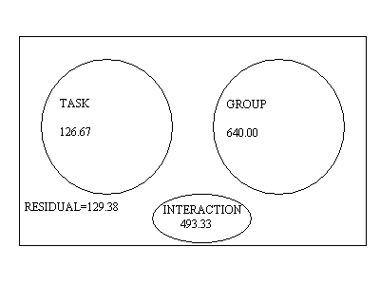
Task and Group are statistically independent

Slide 28
Post-hoc tests (main effects)
Tukey’s HSD for pairwise comparisons
(click post hoc in general linear model:univariate)
Standard Error in ANOVA based on averaging the variances of the five observations in each of the 12 group/task combinations
May be best to look at tasks separately in control group as they behave relatively differently than with the patients
Covered in post-hoc talk

Slide 29
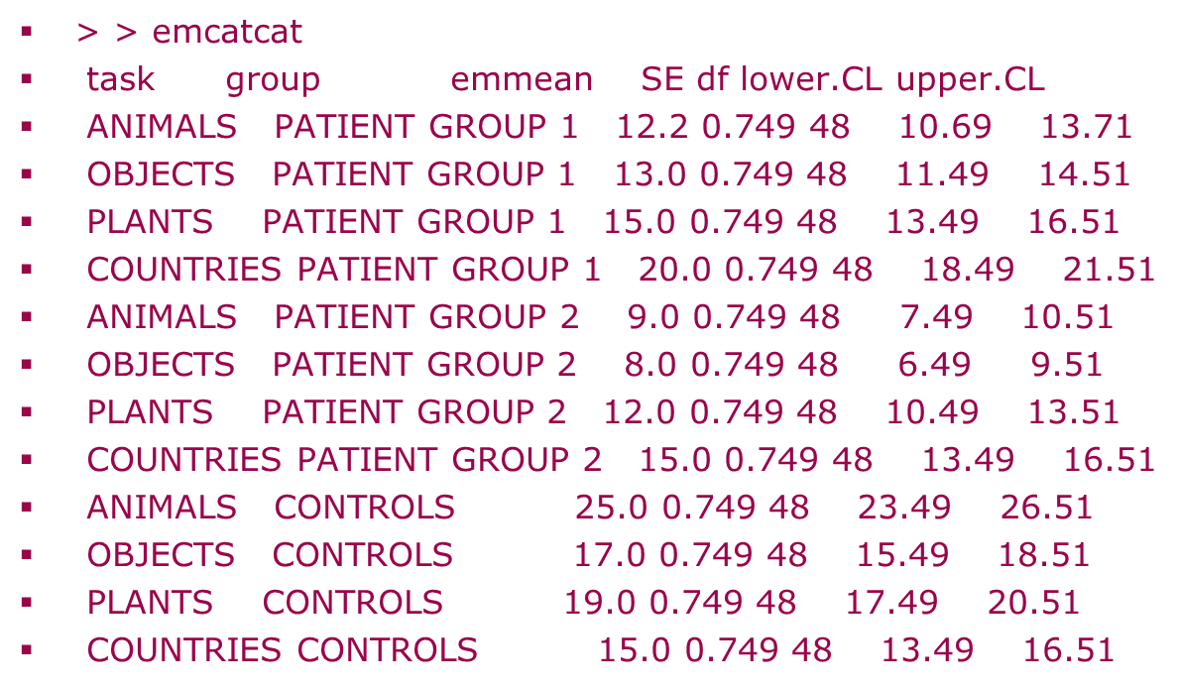
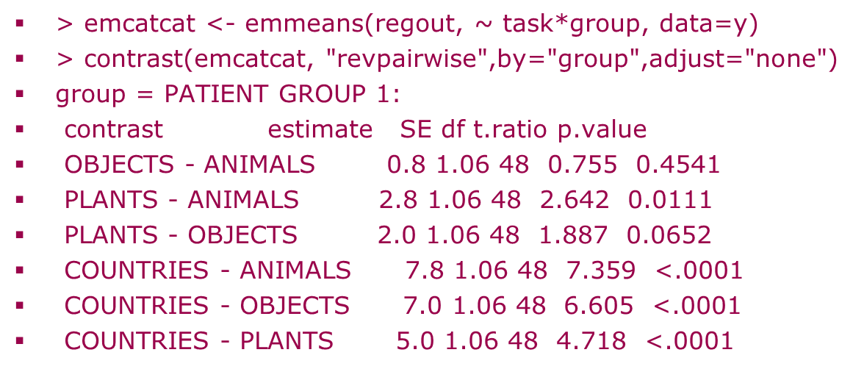
Simple effects

Slide 30
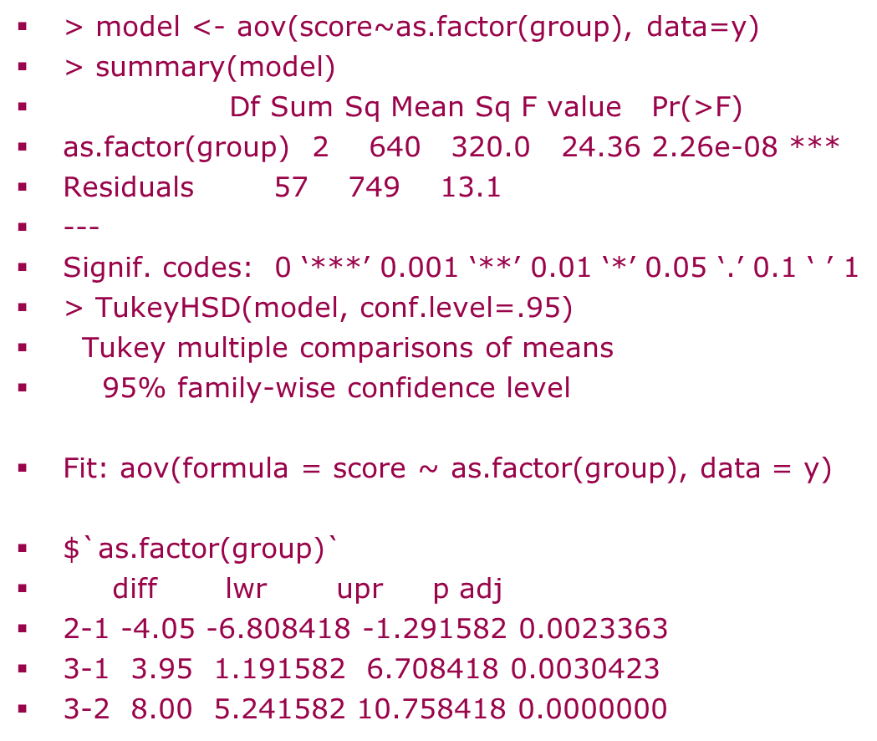
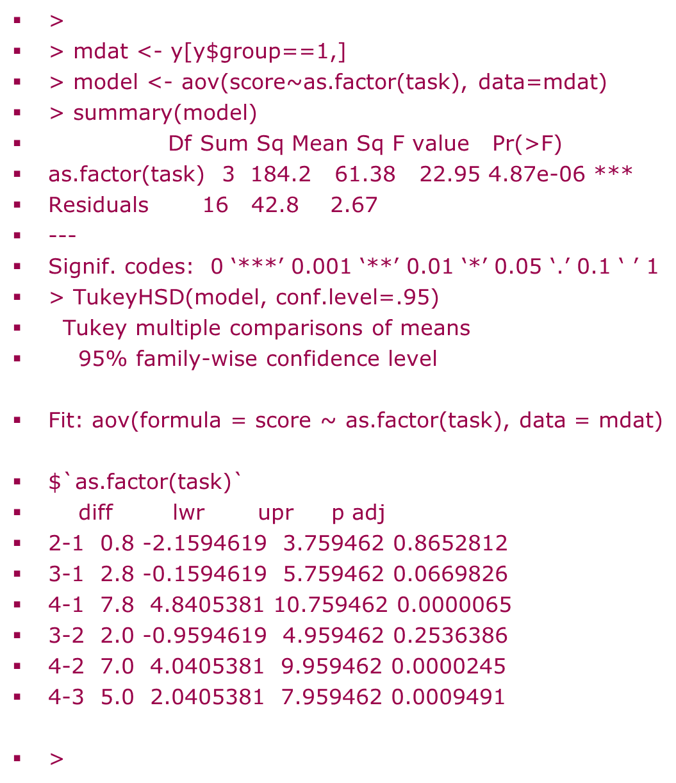

Tukey HSD: use aov(); simple effect of e.g. task for each group
>

Slide 31
Make your design fit your questions
3 IQ groups, 3 naming tasks, 3 age groups (A,B,C)
3 x 3 Latin Square
Task 1 Task 2 Task 3
Group 1 A (n=3) B (n=3) C (n=3)
Group 2 B (n=3) C (n=3) A (n=3)
Group 3 C (n=3) A (n=3) B (n=3)
Can Use 1/3 of all possible factor combinations by using a single observation in each cell

Slide 32
Latin Square example
means
Task 1 Task 2 Task 3
Group 1 19.34 20.45 20.93
Group 2 18.38 22.56 24.24
Group 3 20.82 22.59 24.53

Slide 33
Output - main effects
No significant main effects

Slide 34
But…can’t fit interactions!
Confounded!

Slide 35
Latin squares
Pros
Need fewer people
Adjusts each factor for other two e.g. group differences not due to task or centre
Cons
Assumes zero interactions
Numbers required are large for bigger designs e.g. 12 x 12

Slide 36
UNbalanced study example
2 Predictor variables
  3 status of smokers: Current, Don’t, Have Done in the past
  Family History of smoking: yes or no
Is Blood Pressure influenced by smoking?
This study will not have equal numbers of subjects having smoker/family history combinations in general

Slide 37
Balanced study
Equal numbers in group combinations
Mean Blood Pressure (BP)
Family
History Smoker Status
Non Ex Current
Yes 140.5, n=2 110.5, n=2 127.5, n=2
No 112.0, n=2 119.0, n=2 132.5, n=2
Family histories are equally represented for each smoker status. So
the mean blood pressures for each smoking status do not need to be
adjusted for family history!

Slide 38
History only (Balanced)

Slide 39
Status ONLY (Balanced)

Slide 40
Status and History are statistically independent
Total (for R² calculation)
SS haven’t changed!

Slide 41
R²
Smoking Status alone:
R² = 505.167/2314.667=22%
= Status adjusted for Family History
Family History alone :
R² = 75/2314.667 =3%
= Family History adjusted for Status

Slide 42
Unbalanced study (Boniface,1995)
Unequal numbers in group combinations
Mean Blood Pressure (BP)
Family
History Smoker Status
Non Ex Current
Yes 126.57,n=7 121.67,n=6 131.57,n=7
No 111.75,n=8 108.25,n=4 128.17,n=6
Might expect non-smokers to have lower mean blood pressure simply
because they have a higher proportion of people without a family
history of smoking. Need to adjust for family history.

Slide 43
History ONLY (Unbalanced study)

Slide 44
Status ONLY (Unbalanced design)

Slide 45
Status and History are not statistically independent….
STATUS AND HISTORY SS HAVE CHANGED!

Slide 46
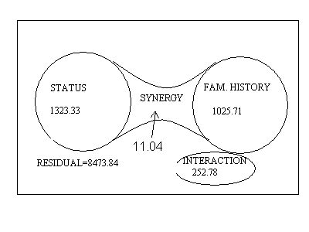
Whole is more than the sum of the parts in Unbalanced designs!

Slide 47
Model for unbalanced data
Est. BP for smoker with no family history =
121.33+8.54-5.27+3.57=128.17
Expected blood pressure for random individual =
121.33
+
-2.17
-6.37
8.54
5.27
-5.27
+
2.14 -2.14
1.44 -1.44
-3.57 3.57
+
Overall Mean
Family History
Smoking Status
Smoking Status by Family History

Slide 48
Effect Sizes (as % of Total SS)
Status alone: 1323.33/11086.76=12%
Family History alone : 1025.71/11086.76=9.3%
Status (Adjusted for Family History) : 1334.37/11086.76=12%
Family History (Adjusted for Status): 1036.81/11086.76=9.4%
In Unbalanced designs need to take into account other predictors when explaining the effect of a particular variable on a response

Slide 49
Unweighted means (Type III SS in SPSS)
Howell (2002) can approximate SS in ANOVA using unweighted means
Family
History Smoker Status
MEANS
Non Ex Current weighted unweighted
Yes 126.57,n=7 121.67,n=6 131.57,n=7 126.85 126.60
121.65 121.33 Midpoint
No 111.75,n=8 108.25,n=4 128.17,n=6 116.44 116.06
SS(History adjusted for Status and Status by History) : 2 x nH x (126.60-121.33)² =1007.35 where nH = 3 x (6/(1/7+1/8+1/6+1/4+1/7+1/6) = 18.11

Slide 50
Weighted means
SS(History) = 20 x (126.85 – 121.65)² + 18 x (116.44-121.65)²
= 1026.64 approx = 2 x 18.95 (126.85-121.65) ²
Family
History Smoker Status
MEANS
Non Ex Current weighted=arith mean
Yes 126.57,n=7 121.67,n=6 131.57,n=7 126.85 (n=20)
121.65 (mean)
No 111.75,n=8 108.25,n=4 128.17,n=6 116.44 (n=18)
Can use weighted means to work out SS(History adjusted for Status) (convoluted)

Slide 51
How do we treat main effects in a model containing interactions involving these main effects?
Nelder (1994) , Langsrud (2003) and others suggest looking at main effect Sums of Squares (SS) after removing interaction terms involving that main effect provided those interactions are not significant e.g. omitting the AxB interaction if it is not significant to look at A or B so using SS(A given B in model) and SS(B given A model).
Weighted combinations of means can work out SS(A) and SS(A given B) (and SS(B), SS(B given A)); Only unweighted (equal n) combinations of means work out SS(A | B, AxB) and SS(B | A, AxB)
SS are usually evaluated using changes in model fit for addition or deletion of factors of interest by comparing different regressions.
SS using weighted combinations of means also called Type II SS; SS using unweighted (equally weighted by sample size) combinations of means are called Type III SS

Slide 52
Balanced/Unbalanced summary
Balanced
Planned
Equal combination sizes
Don’t have to adjust at analysis stage to examine an effect
No synergy
UNBalanced
Unplanned
Unequal combination sizes
Average cell sizes using Harmonic mean (Type III SS in SPSS) although Nelder (1994) advocates a type II weighted SS
Need to adjust at analysis stage to examine an effect
Synergy present
(positive or negative)

Slide 53
An apparent contradiction!
We have NO interaction
But different results in the groups

Slide 54
Explanation is…
There is no interaction because all of the differences between English and Japanese are not significantly different from zero
Even though
The English syllable scores differ and the Japanese do not

Slide 55
Thanks to...
David Boniface
Ian Nimmo-Smith
References:
Boniface DR (1995) Experiment Design and Statistical methods for behavioural and social research Chapman and Hall:London in CBSU library).
Howell DC (1992, 1997,2002) Statistical Methods for psychologists (Five editions) Wadsworth:London in CBSU library.

Slide 56
Next week…. 11am
Repeated Measures and Mixed Model ANOVA

