Slide 1
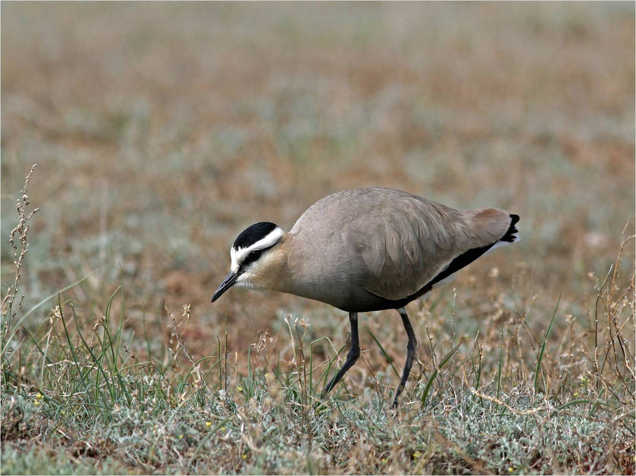
The cost of saving nature: how much and is it a price worth paying?
Donal McCarthy, Royal Society for the Protection of Birds
7th May 2015

Slide 2
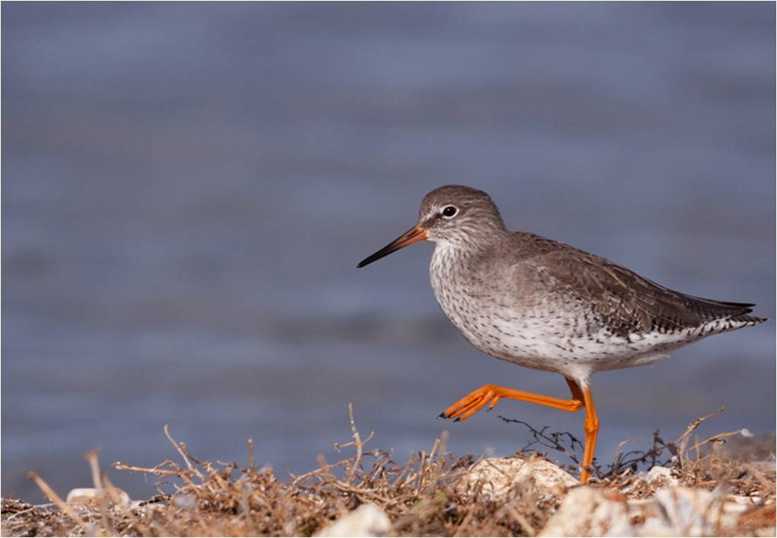
Overview
Nature is in trouble: the state of nature
What are the threats?
What are the solutions?
How much will it cost?
Is it worth it?
Conclusions

Slide 3
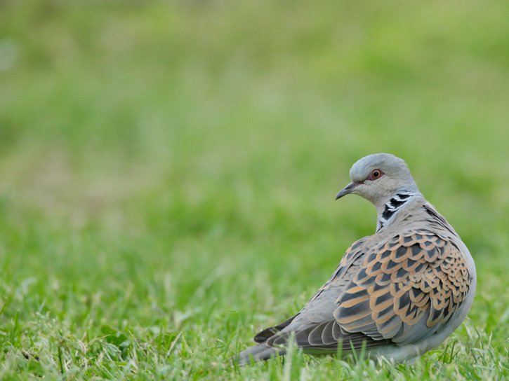
Nature is in trouble: UK
60% of those species for which data available have declined over last 50 years. One in ten species at risk of extinction.
44 million breeding birds (one in five) lost in less than 50 years, along with over 90% of wildflower meadows. 75% of butterfly species are in decline.
Turtle Doves down 95% since 1995....and only one pair of Hen Harriers nested successfully in England in 2014.
77% of species found in the UK Overseas Territories (which hold 90% of threatened wildlife for which UK is responsible, including more penguins than any other nation and 10 times the number of endemic species as the UK mainland) are globally threatened.

Slide 4
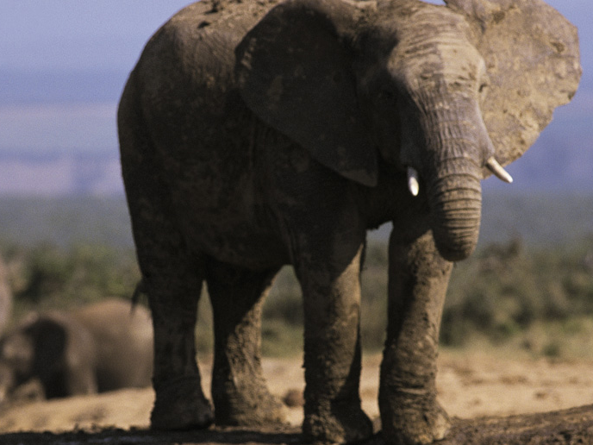
Nature is in trouble: Global
One third of amphibians, one quarter of mammals, and one fifth of plants are threatened with global extinction.
Since 1970 (in less than two generations), population sizes of vertebrate species have dropped by half on average.
1.5 Earths currently required to meet the demands humanity makes on nature each year.

Slide 5
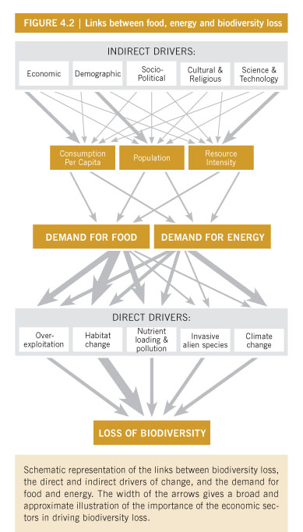
Major Threats
World GDP per capita has more than tripled since 1950, but changes in biodiversity due to human activities have been more rapid than at any time in human history. Extinction is a natural process, but current rates are significantly higher than what might be considered natural.
The loss of nature is a consequence of the way we produce the things we choose to consume, the amount we consume, and the number of us consuming.
Direct drivers of loss:
  Habitat destruction/degradation
  Over-exploitation
  Invasive species
  Pollution and climate change (one-sixth)
Indirect drivers:
  Socio-economic factors influence consumption per capita (e.g. demand for food, energy, and other resources), population (size and growth) and technology.
  People are increasingly disconnected from nature.

Slide 6

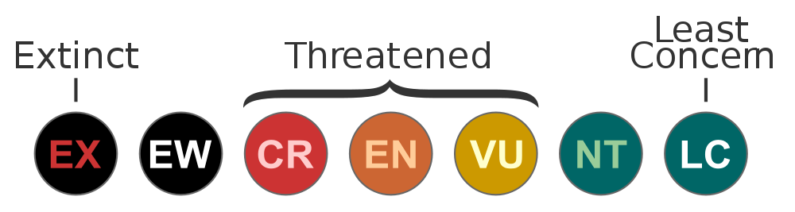
What makes a species threatened?
The IUCN Red List is widely recognized as the most comprehensive, objective global approach for evaluating the conservation status of plant and animal species. It provides a scientifically rigorous approach to determine risks of extinction that is applicable to all species, has become a world standard.
Set of hierarchical categories and key criteria relating to population size, distribution, and trends.
Small population, small range size, and/or rapid decline = threatened. Most threatened birds have populations below 10,000 individuals, some are as low as 50 individuals.
In contrast, there are nearly 4 million pairs of breeding blue tits in the UK alone (and up to 50 million pairs across Europe as a whole).

Slide 7
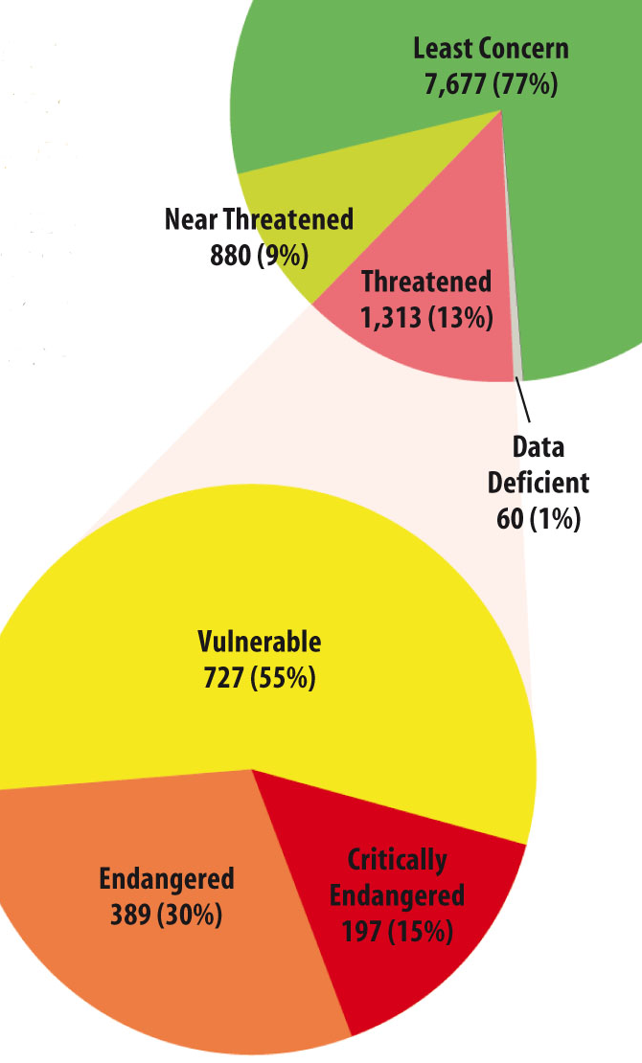
State of the World’s Birds
13% of bird species globally threatened with extinction (1 in 8).
Approx. 200 species classed as Critically Endangered (extremely high risk of extinction), 400 as Endangered (very high risk of extinction) and 700 as Vulnerable (high risk of extinction).
An additional 1,000 species are classed as Near Threatened because they are close to qualifying as globally threatened.
There has been a steady and continuing deterioration in the status of the world’s birds over the last 25 years

Slide 8
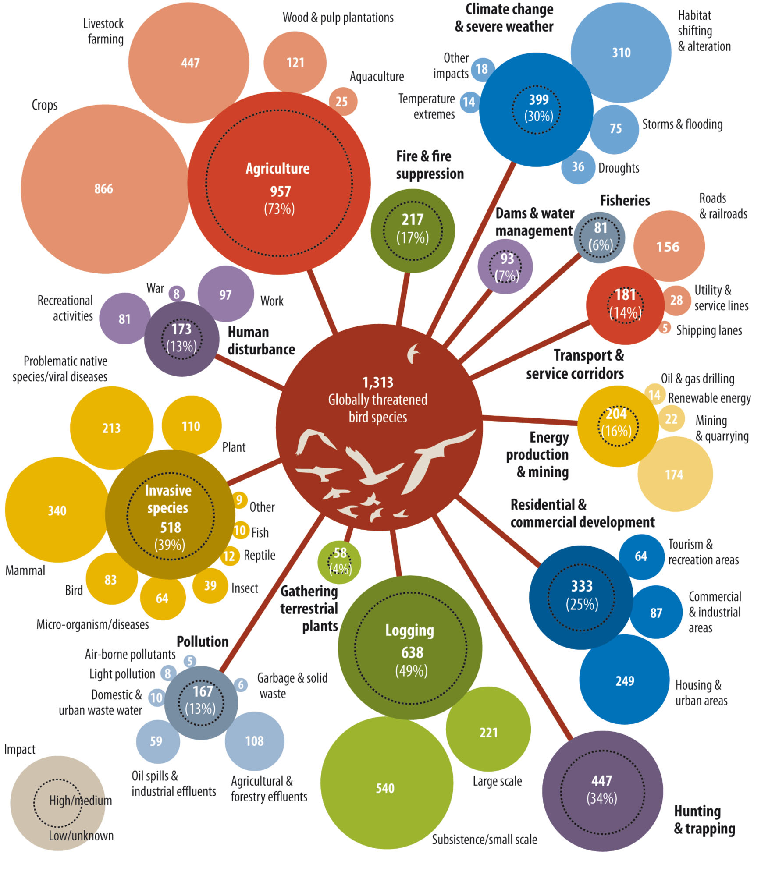

Slide 9
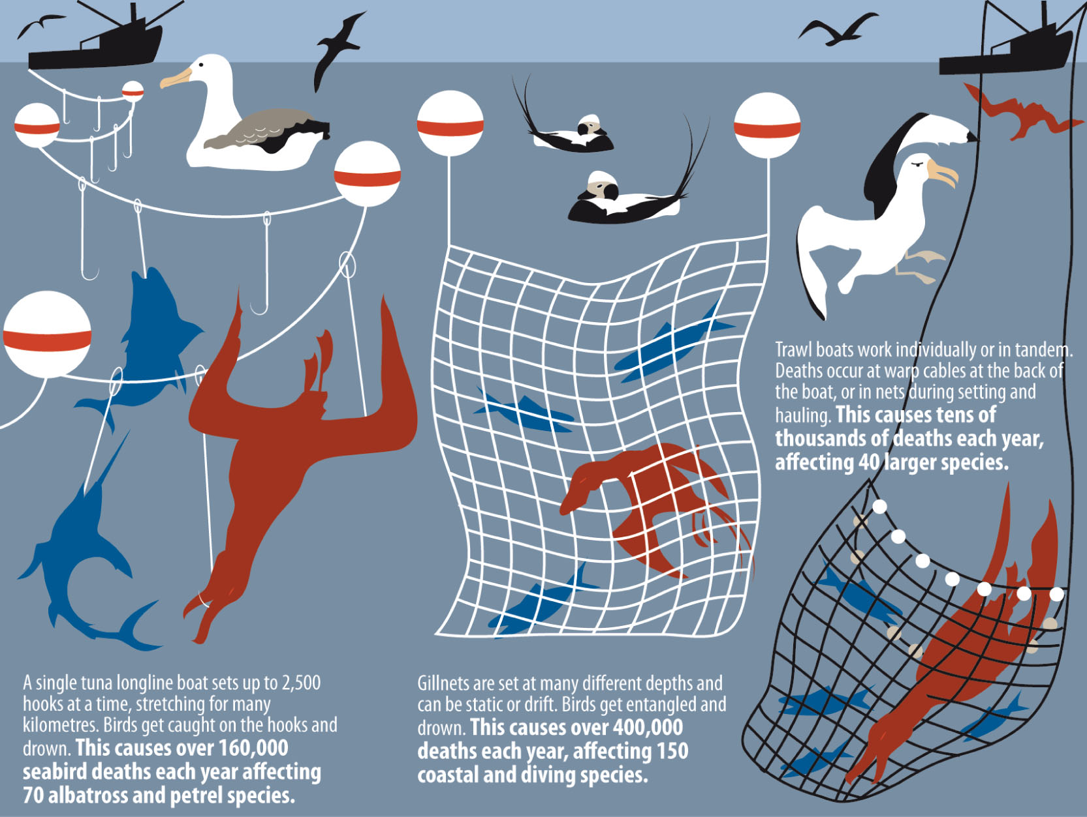
At sea, birds face particular pressures from unsustainable fishing practices. Currently, 17 of the world’s 22 albatross species are threatened with extinction.

Slide 10
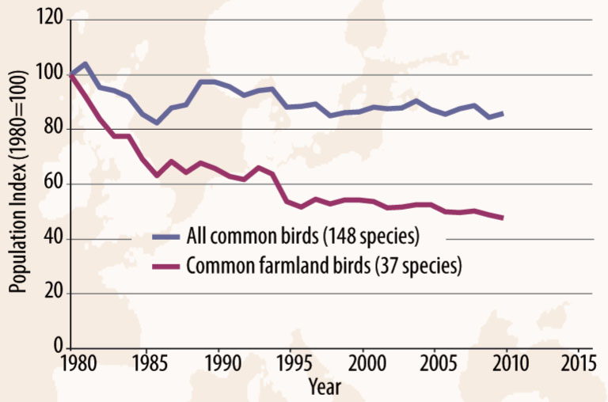
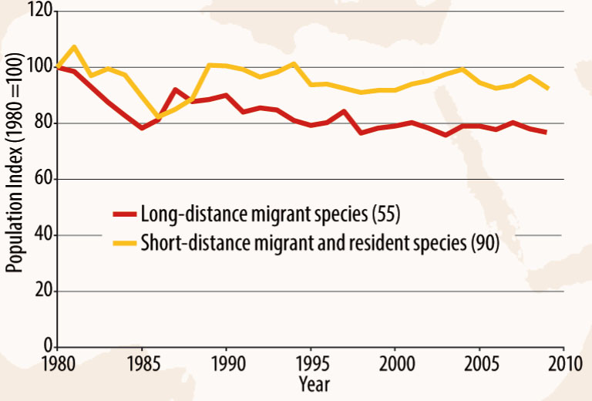

Slide 11
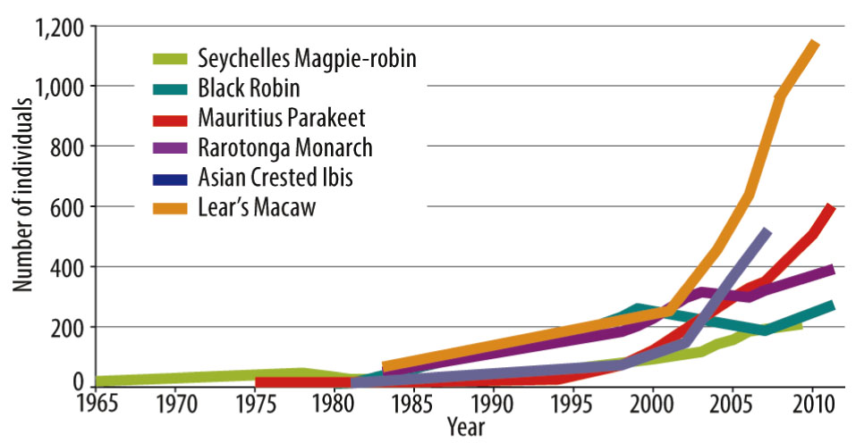
Saving Birds from Extinction

Slide 12
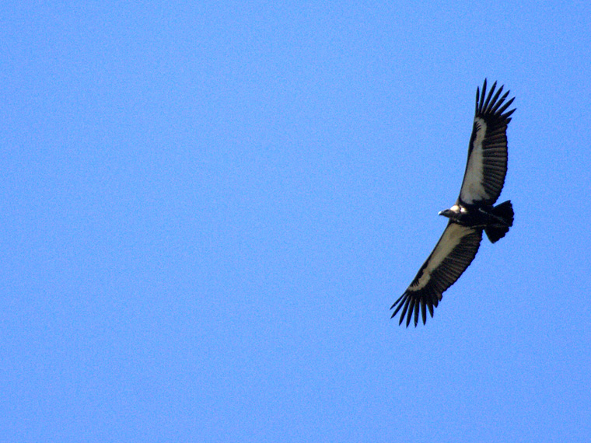
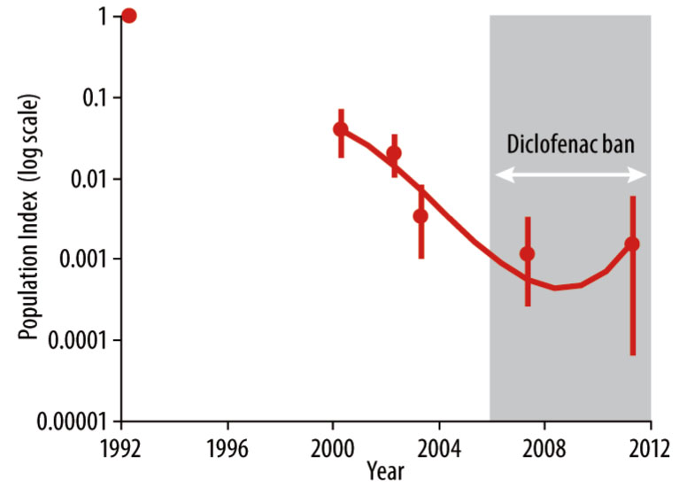
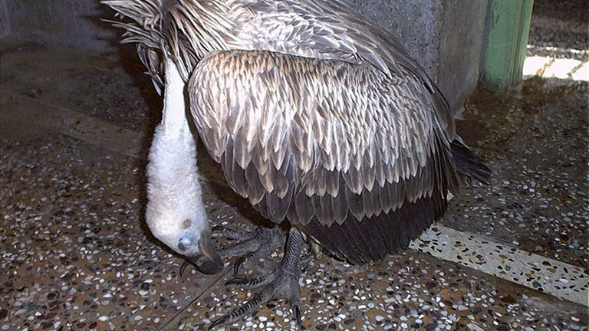
Bringing Vultures Back from the Brink

Slide 13


Solving the Crisis: CBD and the Aichi Targets
The Convention on Biological Diversity (CBD) entered into force in 1993 following the 1992 Rio Earth Summit. Its key objectives are:
  The conservation of biological diversity
  The sustainable use of the components of biological diversity
Parties to the CBD committed to achieving a significant reduction in the rate of biodiversity loss at the global, regional and national level by 2010, but this target was not achieved (Butchart et al., 2010).
  In fact, evidence collected at the time suggested that the rate of loss continued to increase, along with many of the key drivers of loss. One of the key reasons for this failure was almost certainly inadequate funding.
New Strategic Plan agreed in 2010 with 20 Targets for 2020. However, the decision on how to mobilize resources to meet the targets was postponed to the next meeting in 2012, partly through lack of information on costs.

Slide 14
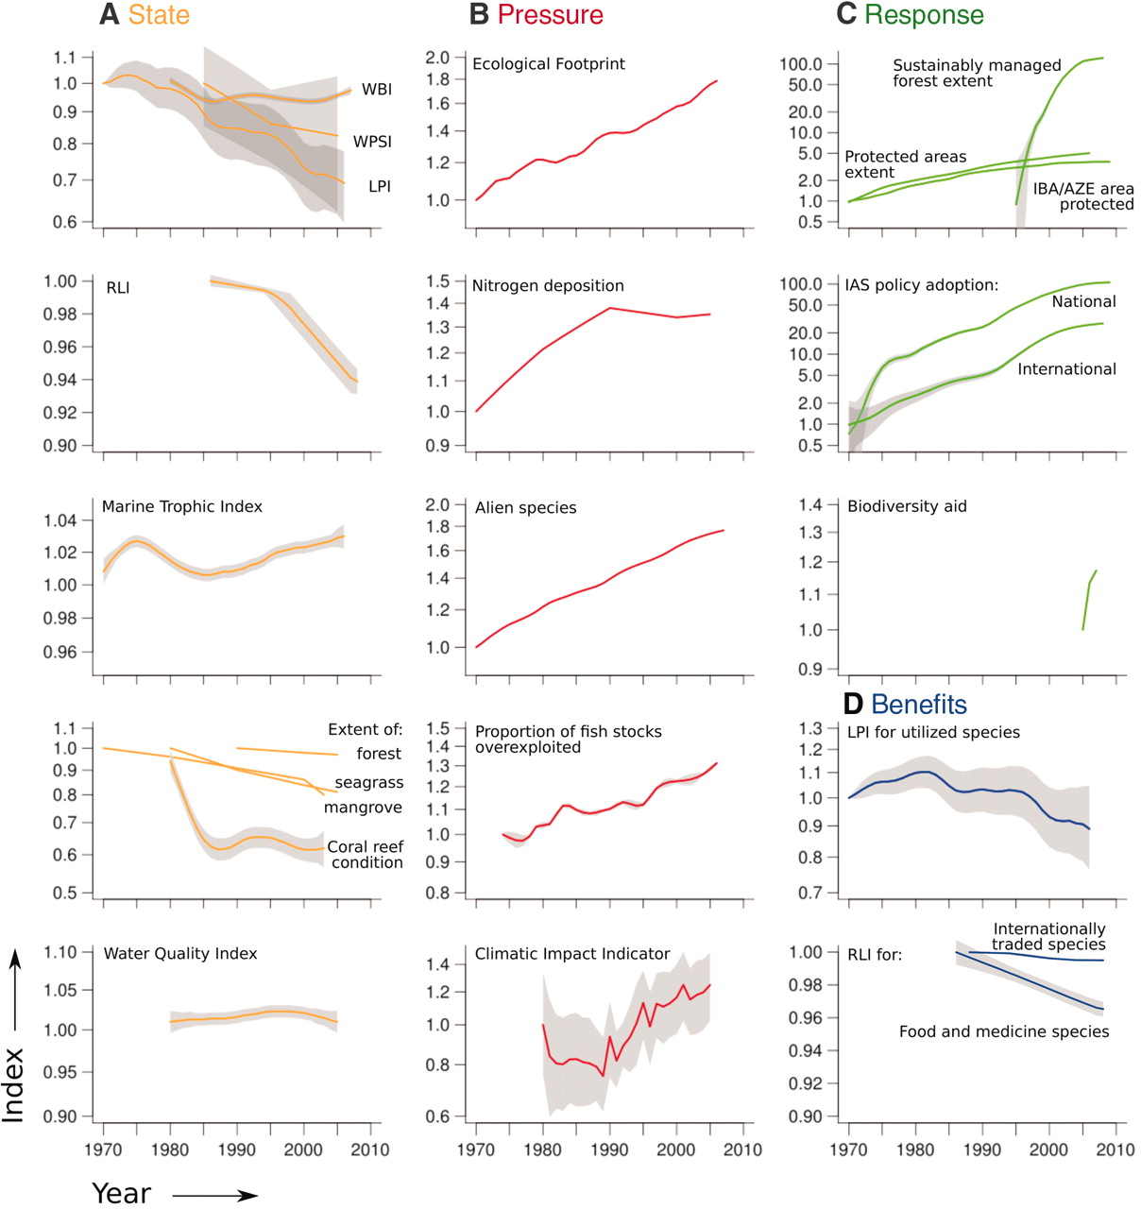
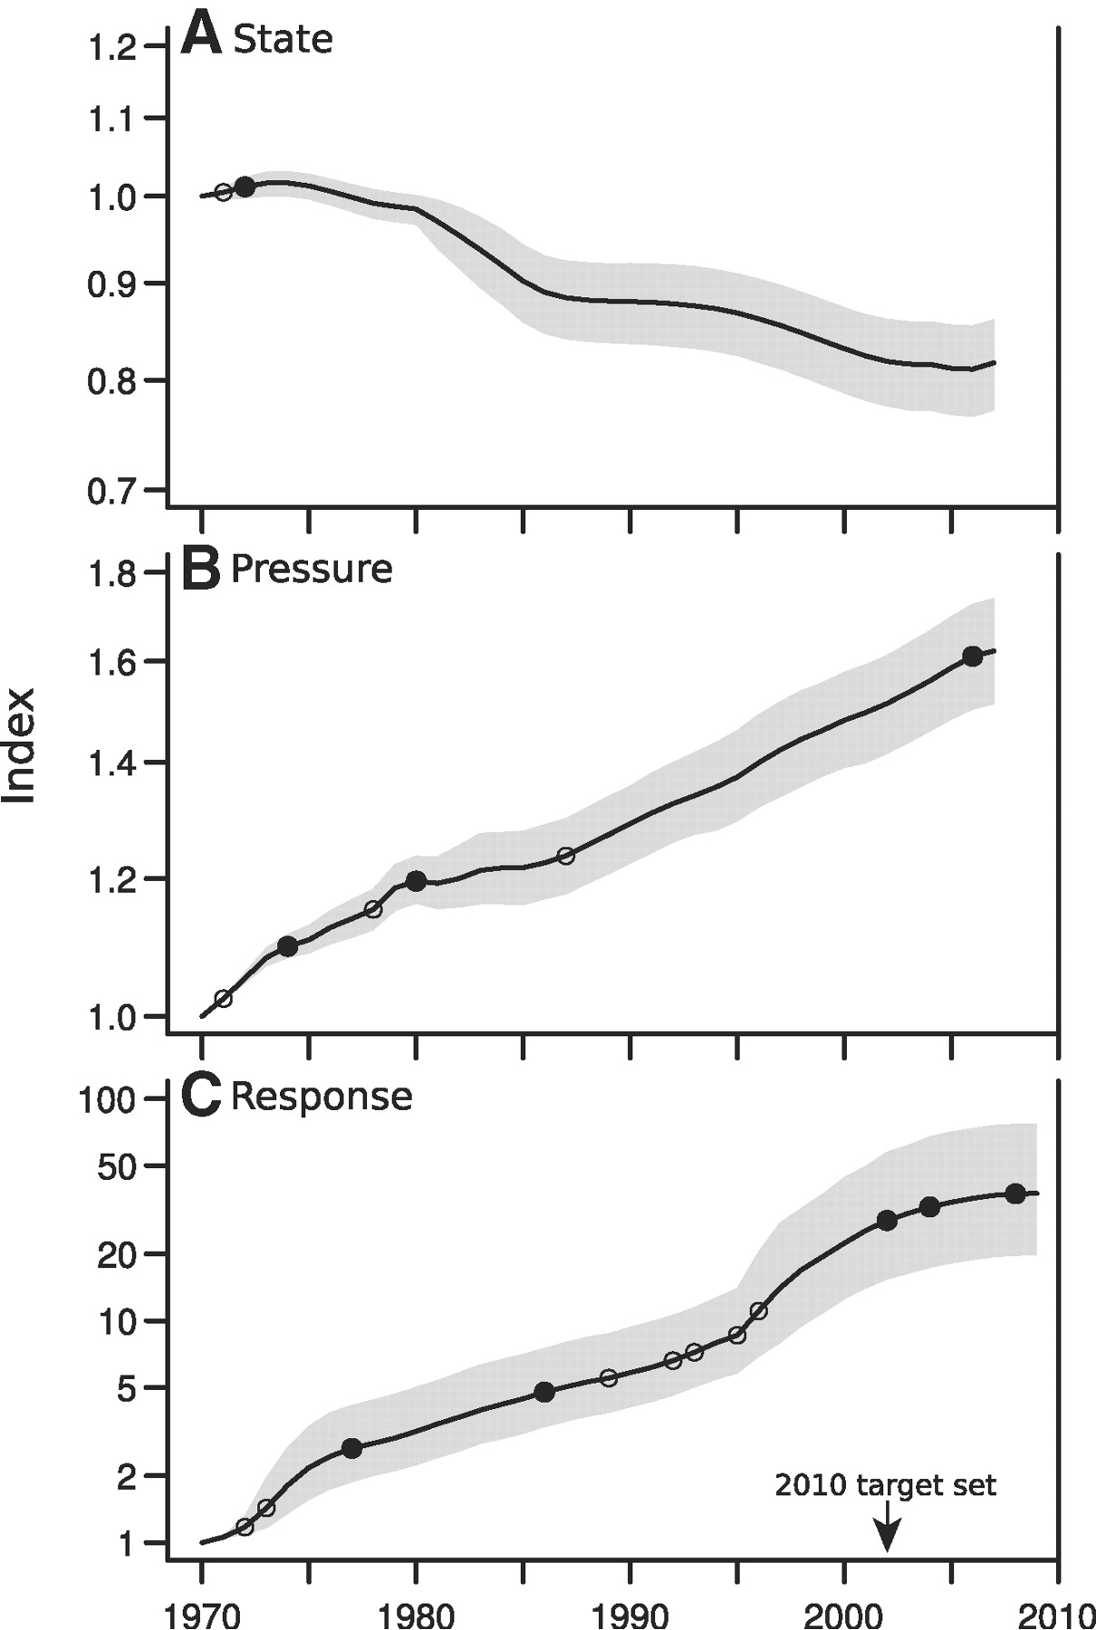
Source: Butchart et al. (2010)

Slide 15
But how much will it cost?
CCI Project: Assess costs of meeting two key targets to help inform resource mobilization negotiations.
  Target 11: conserve “at least 17 per cent” of the terrestrial environment “…especially areas of particular importance for biodiversity …..through effectively and equitably managed…systems of protected areas…”
  Target 12: prevent the extinction of known threatened species and improve their conservation status “…particularly those most in decline”
Used data on birds, the best known class of organisms, to assess the financial costs of meeting the two targets “for all nature” and the gap between total needs and current expenditure.
Financing Gap = Required - Current Spending
  What is currently being spent? How much in total is required?
  How big are the gaps (between needs and available resources)?

Slide 16
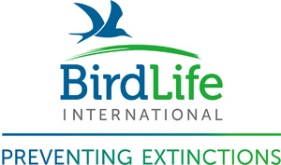
Threatened Species (Target 12)
  Cost of improving status of all threatened species by 1 IUCN Red List Category within next decade.
  Species-specific targets set based on minimum improvements in status needed in order to be species to be “downlisted” to a lower Red List Category within next decade.
  List of categorized conservation actions identified for each species to tackle major drivers of loss; (e.g. site protection, species management, research and monitoring). Respondents asked to amend and specify as “essential” or “supporting”.
  Expert-based assessment using structured questionnaires sent to >300 experts across the world. Data on sample of approx. 20% of all globally threatened birds. 65% response rate.
  Min-max range estimates for each action of (a) annual cost , (b) the number of years required and (c) “baseline” expenditure over last decade

Slide 17
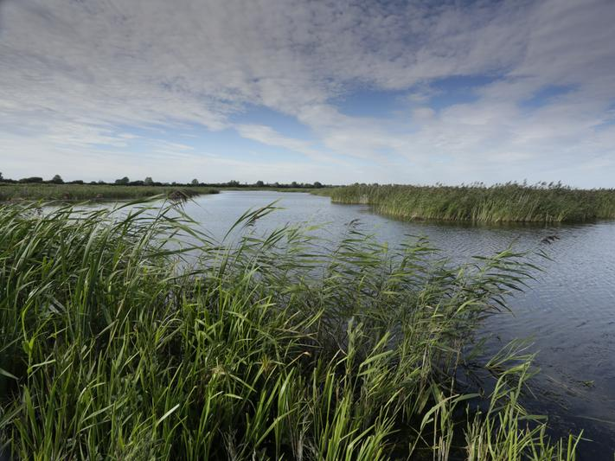
Species cost model
  Extrapolate from sample to all globally threatened bird using general linear model
Explanatory variables:
  Species traits (IUCN Red List category, migratory status, forest dependence, island endemism, breeding distribution extent)
  Socio economic indicators averaged over (breeding) range states (e.g. GDP per km²)
Total cost a positive function of (altitude-adjusted) breeding range size, forest dependence (low to high), and GDP per km².
Excluding range size, Red List category and island endemism (Y/N) become significant predictors.

Slide 18
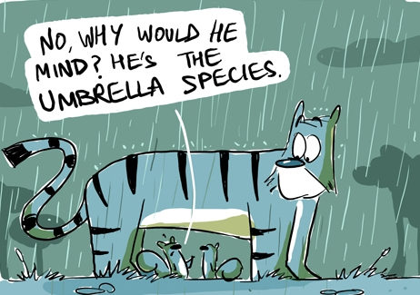
Accounting for overlapping costs
Many categories of action will probably benefit all those species whose distributions overlap i.e. cost “sharing” among spatially co-occuring species
Categorized actions as “species-specific (unshared)” or “shared”; only 20% of costs are for species-specific actions such as captive breeding
Using species range maps spread shared costs across all 1km grid cells within each species’ range.
Maximum cost per grid cell summed across all grid cells
S1
 | Shared Cost
 |  | S2

Slide 19
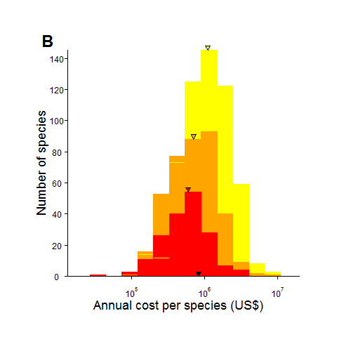
Results: Species (Birds)
Total Required
US$0.88-1.23 billion (annually)
Median cost (per species) = US$0.85 million (annually)
CR species comprise 10% of the total
(B) Current
Median (per species) = US$65,000 (annual)
Covers only 12% of needs (median across sample)
Recent funding adequate (>90% of estimated need) for only 3% of species and <50% of estimated needs covered for 86% of species.

Slide 20
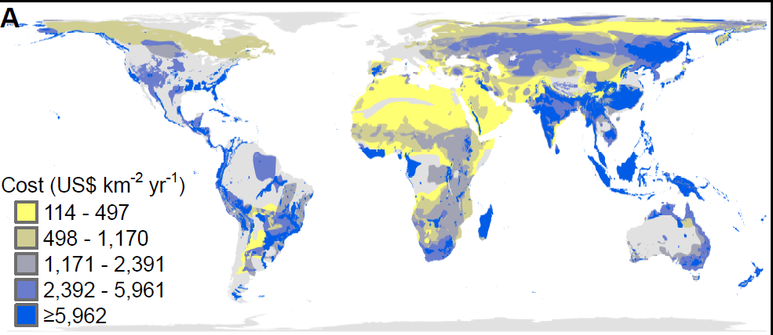
Geographic patterns in the annual cost for conservation actions (U.S. $ km−2) for globally threatened bird species

Slide 22
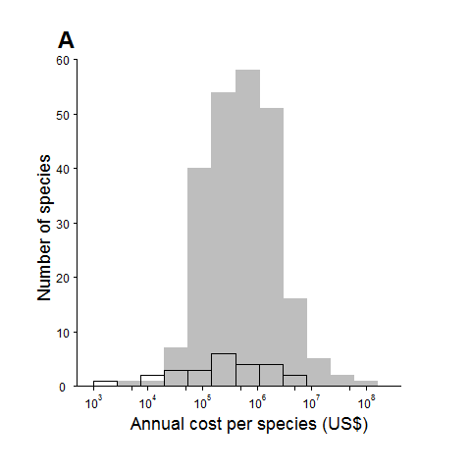
Past downlistings vs. Model Costs
Compared with actual costs for 25 bird species that have experienced genuine improvements in their Red List Status since 1988 (out of 42)
Similar range of costs, although
lower median for past downlistings

Slide 23
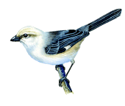
Costs of past successes?
Pale-headed Brush-finch (Atlapetes pallidiceps):
CR:D1 (<50 mature individuals) to EN:D1 (<250 mature individuals)
Found in Southern Ecuador, the remaining 27ha of suitable habitat was purchased in 1999 and fenced to remove excessive grazing pressure. Some predator control was also carried out.
$350,000 in total ($35,000 per year) spent on land acquisition, reserve management and predator control.
On-going cost of $15,000 a year (<50%)

Slide 24
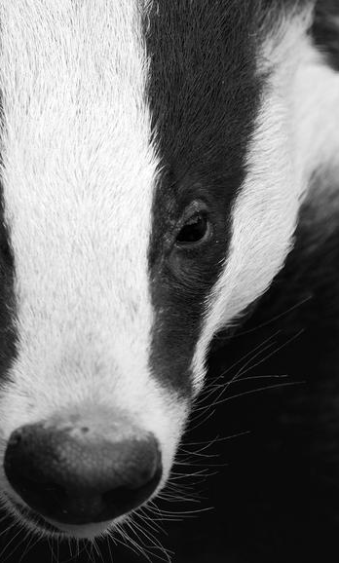
Extrapolating to all threatened species
Approx. 13,000 known non-avian threatened species (no. of threatened birds x 12).
Found that median costs for birds are approx. 4 time higher than median costs across all other non-avian taxa (lit. review)
Results: US$3.4 – 4.76 billion

Slide 25
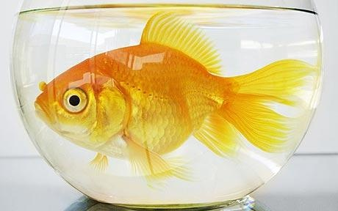


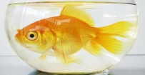

Is this a lot?
Preventing extinctions (CR bird species) = US$125 million a year = <30% of U.S. spending on “pet insurance” in 2011.
Total needs (US$5 billion) 10% of total spending on “pets” in the U.S. (e.g. pet food + pet insurance + pet clothing + pet services [grooming etc.]…..)
<50% of spending in Europe on ice-cream and <$5 per person per year in the world’s richest nations.
≈ Consumer spending on video games in 1st quarter of 2011 in USA.

Slide 26
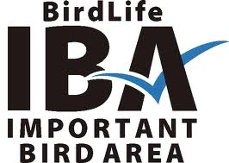
Sites (Target 11)
Protected areas (for example, nature reserves, national parks and wilderness areas) are a cornerstone of national and international efforts to conserve biodiversity.
Why IBAs? Largest systematically identified global network of important sites for biodiversity (sites of global significance).
>11,000 sites identified based on clear quantitative criteria (e.g. presence and abundance of threatened or restricted-range species).
28% of terrestrial IBAs completely covered by existing protected areas, 23% are partially protected and 49% are entirely unprotected
Protection of all unprotected /partially protected IBAs (32% of which are in lower-income countries) would increase terrestrial protected area coverage to 17.5%

Slide 27
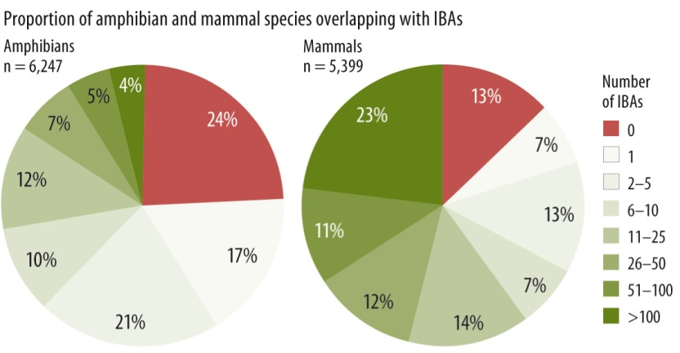
Extrapolating to all KBAs
Globally important sites (‘Key Biodiversity Areas’) have also been systematically identified for other taxa (mammals, amphibians and certain reptile, fish, plant and invertebrate groups) but only in 12 countries
70% already qualify as IBAs, covering 80% of the combined area (Butchart et al. 2012)
Used this areal relationship to extrapolate results from IBA analysis to a global network of KBAs.
KBAs
IBAs

Slide 28
Step 1: Recurrent costs of managing protected areas
Recurrent operational and capital costs of effectively managing terrestrial IBAs: collected site-level data on financing requirements for >350 protected areas (overlapping with IBAs) across 50 countries
Modelled required expenditure per hectare as a function of socio-economic variables at the country level, and spatially explicit variables at the site-level. Used results to extrapolate to all IBAs (and then all KBAs). 75% variation explained.
Site-specific explanatory variables generated using IBA polygons and global spatial datasets for population, road density, land cover etc.
Country-specific variables such as GDP per ha, PPP, Human Development Index (HDI) Rank available from World Bank.

Slide 29
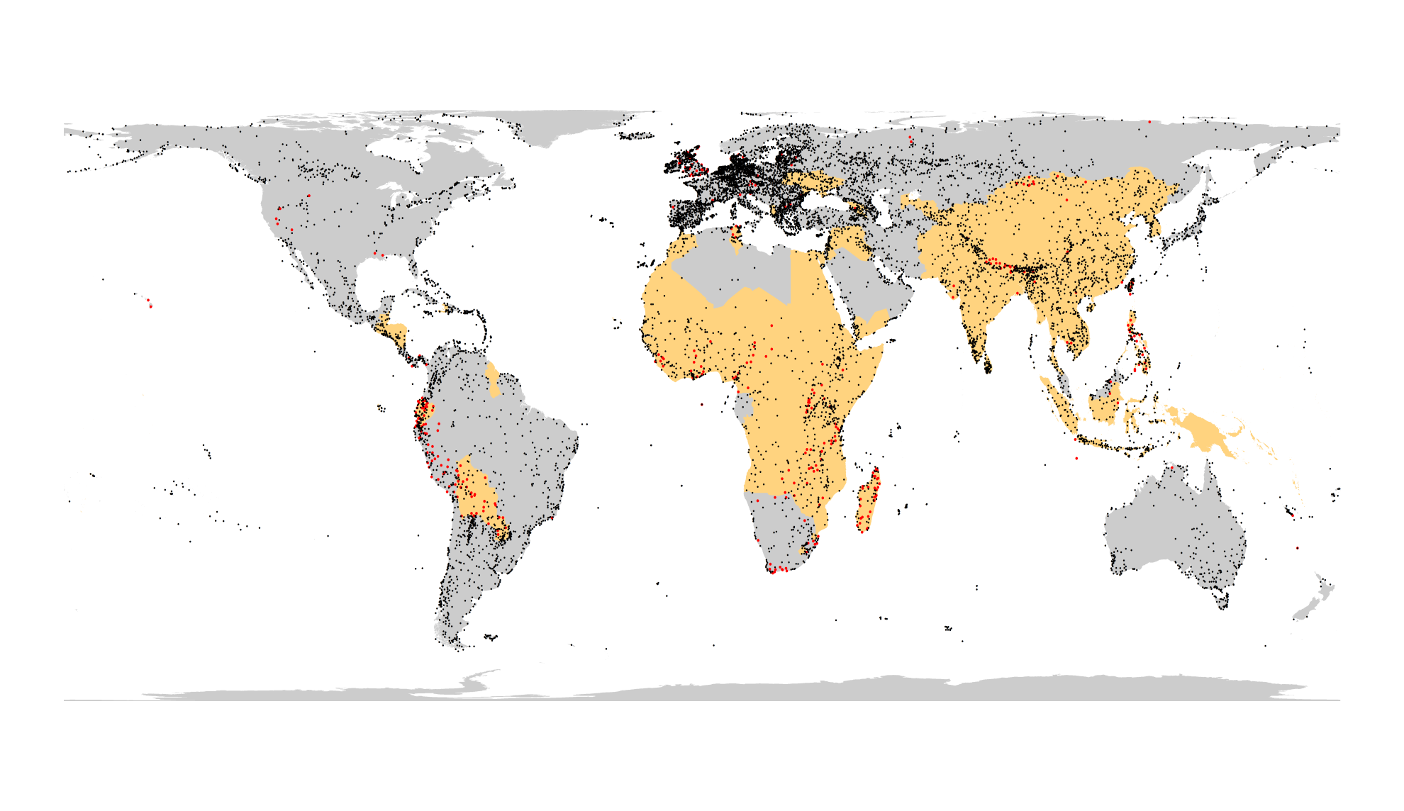
Black dots = all important sites identified for birds
Red dots = sites for which we obtained management cost data
Orange areas = lower-income countries

Slide 30
Size: total costs higher for larger sites, costs per unit area decrease rapidly as the size of a site increases (economies of scale)
Level of threat (proxied by human pop. density) positively correlated with costs.
Economic variables (e.g. GDP): affect wage and other costs. Cost are positively correlated with economic activity as measured by GDP per ha

Slide 31
Results: Protected Area Management Costs (billions per annum)

Slide 32
Step 2: Estimating current expenditure
We also collected data (by country) regarding current expenditure on protected area management (45% of area currently designated)
Current expenditure needs to at least triple to effectively manage existing sites in lower-income countries, and increase by a factor of 6 to effectively manage an expanded IBA network.
Higher-income countries relatively well funded, but shortfalls still significant (>50% in many cases)

Slide 33
Step 3: Expanding the network
Assumed that currently unprotected sites would be “strictly protected” and that full “compensation” would have to be paid.
Used site-level spatially explicit agricultural land values (gross economic rents) from Naidoo and Iwamura (2007) as proxy for purchase or compensation costs.
May be highly variable and depends on existing ownership and management status of the land as well as the type of protection that is deemed most appropriate (land acquisition vs. community-based management). Assumes agriculture always the dominant form of alternative land use competing with nature.
Excludes the actual costs of establishment (e.g. capital investment in equipment/infrastructure, establishing management plans, demarcating boundaries etc.) and associated transaction costs…..could be 3 times the estimated costs of recurrent annual management.

Slide 34
Results: Expanding the Network
$50.7 billion annually required (31% in lower- income countries) for all IBAs
Per hectare costs in higher-income countries more than double what they are in lower-income countries.
Global KBA network: US$58.2 billion annually
Total Site Costs: $58.2 + $17.9 = $76.1 billion

Slide 35
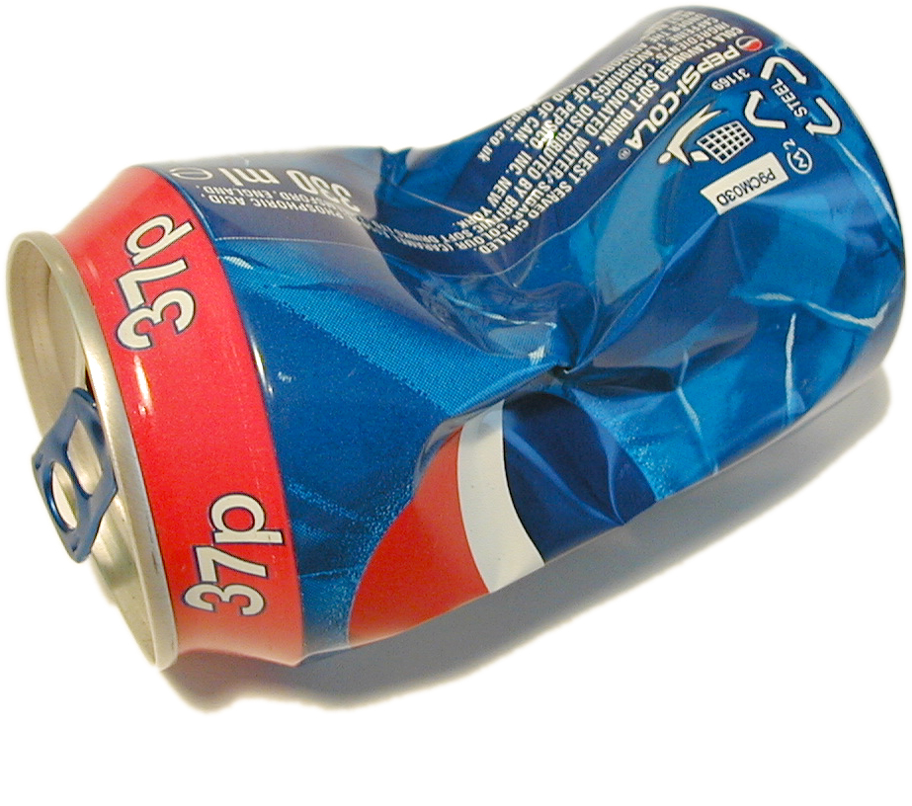
Total Needs: A lot?
Combining costs for (Target 11) and (Target 12) yields a total cost of almost $80 billion annually. Order of magnitude increase required!
50% of “bankers bonuses” paid in 2011 by 7 major Wall street banks ($156 billion)
<20% of global consumer spending on soft drinks in 2011 (US$469 billion)
<10% of fossil fuel subsidies (US$1,000 billion), or world military expenditure (US$1,700 billion)
<0.1% of Global GDP
Notes:
Protecting and managing sites 50% of the total costs for sampled bird species
Will contribute to a number of other CBD targets
Compared site-based cost estimates across targets to help validate results

Slide 36
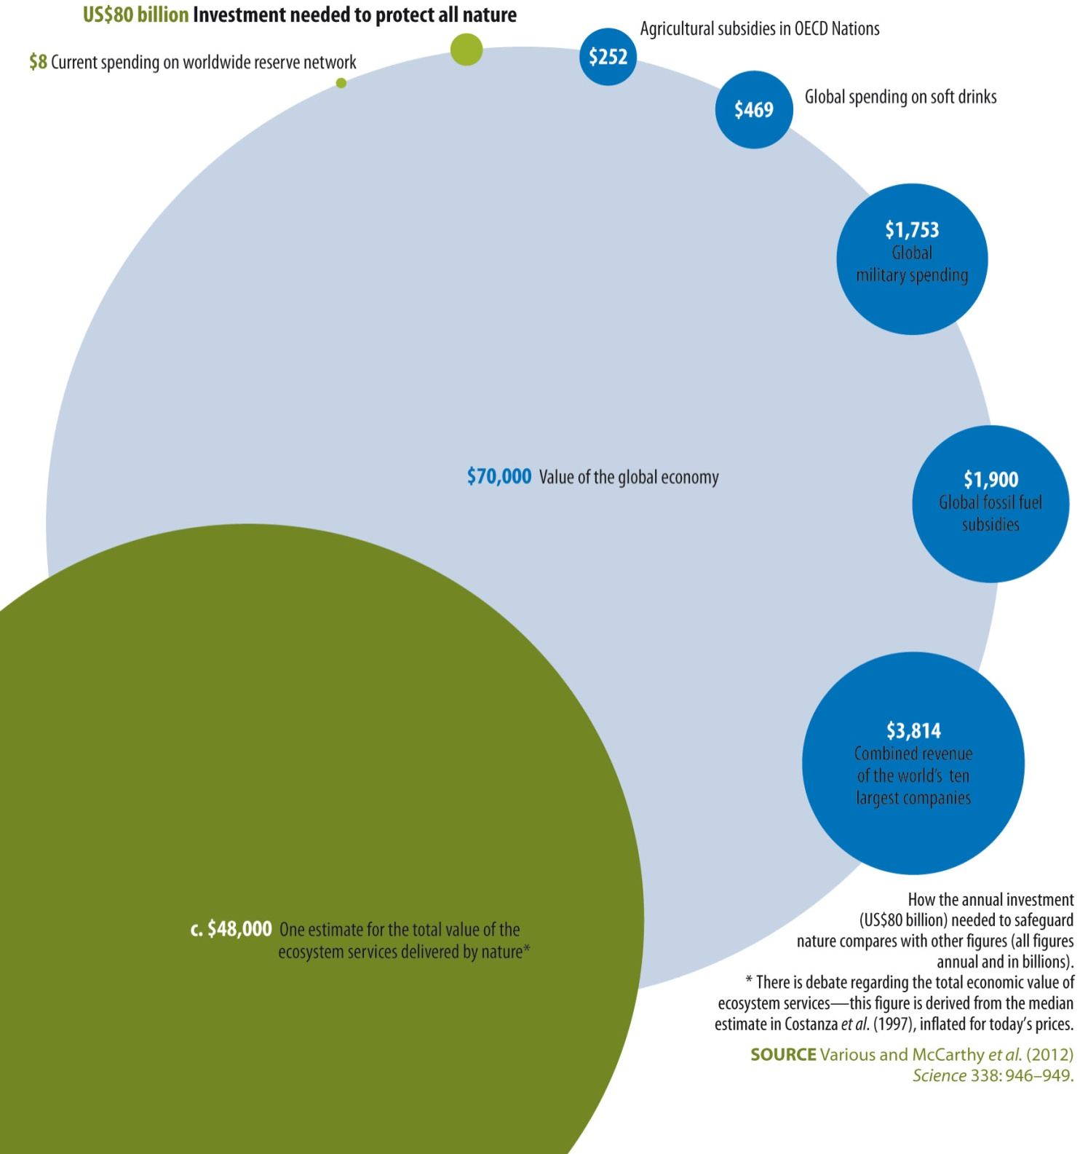

Slide 37
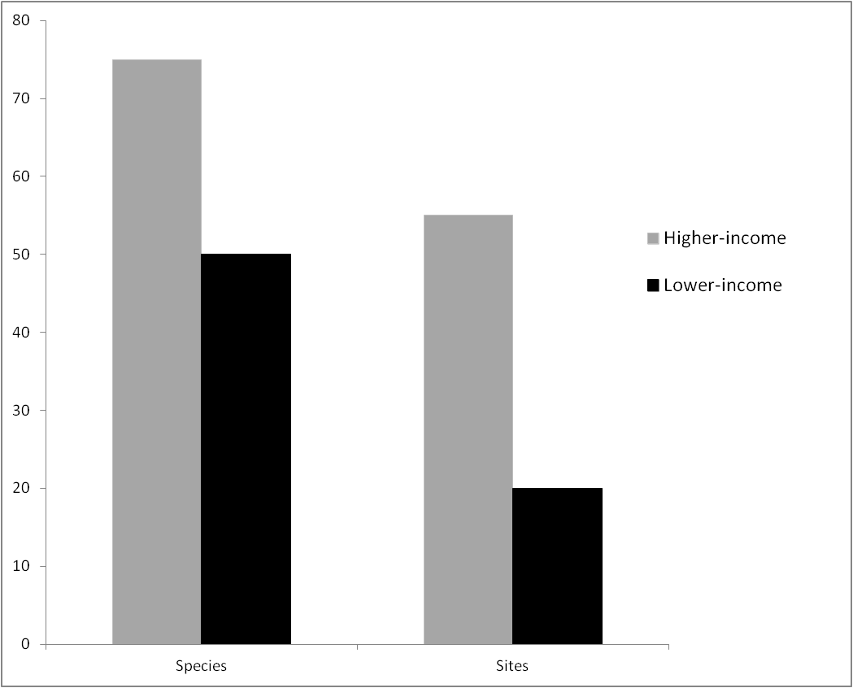
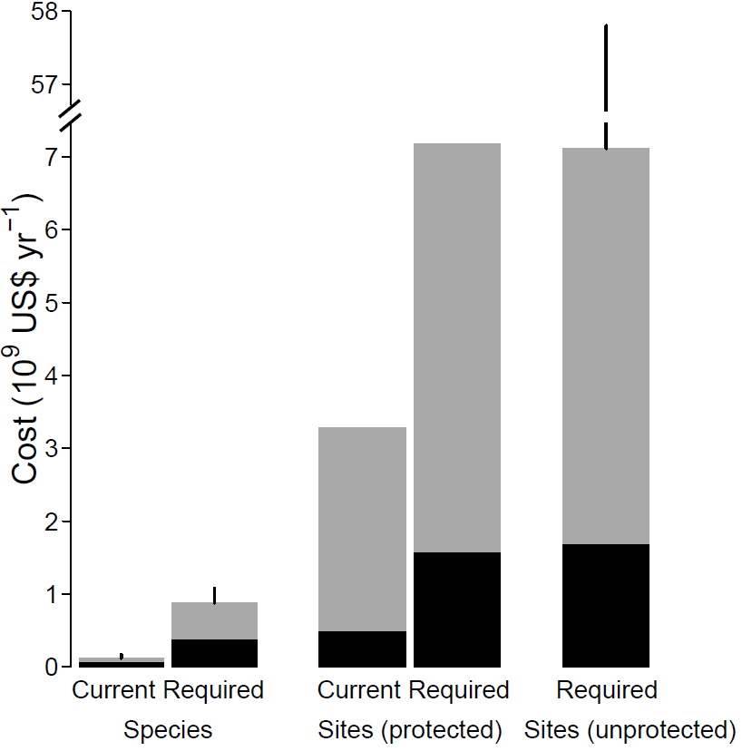
Results: Summary
Financing Needs (annual): US$78.1 billion (<30% in lower-income countries)
Target 12: Improving the conservation status of threatened species
  US$3.4 - 4.8 billion
Target 11: Effectively safeguarding a network of important sites
  US$76.1 billion
Current Spending:
  An order of magnitude below total financing needs.
  Only 12% of estimated needs being met for GTBs. For existing protected areas in lower-income countries, only 31% of estimated needs being met.

Slide 38
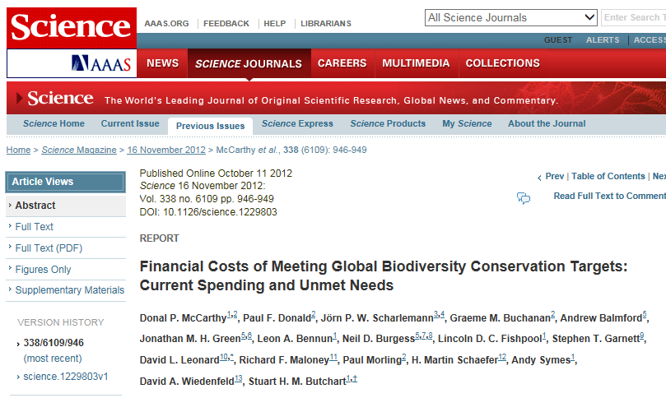
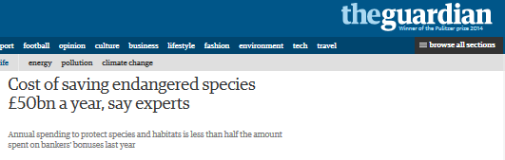
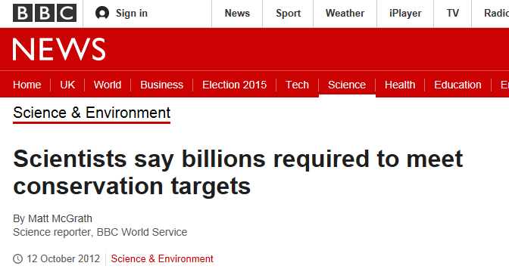

Slide 39
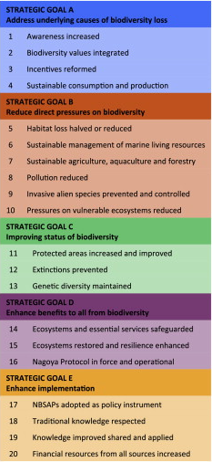
Outcome
High profile launch the week of COP11 (late 2012).
Developed countries agreed to double funding (by 2015) to support developing countries in meeting the goals of the Strategic Plan for Biodiversity 2011-2020.
But latest progress report (2014) is not so positive:
“In most cases progress will not be sufficient to achieve the targets set for 2020, and additional action is required to keep the Strategic Plan for Biodiversity 2011–2020 on course.”

Slide 40
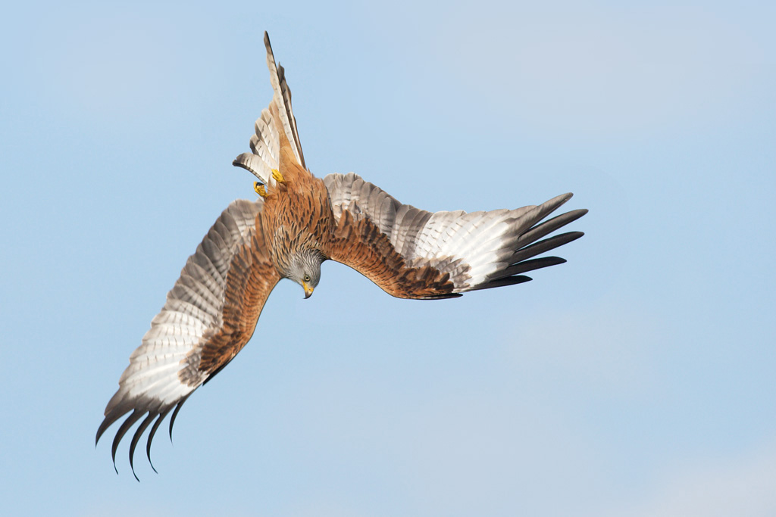
“The question is whether any civilization can wage relentless war on life without destroying itself, and without losing the right to be called civilized.”
― Rachel Carson

Slide 41
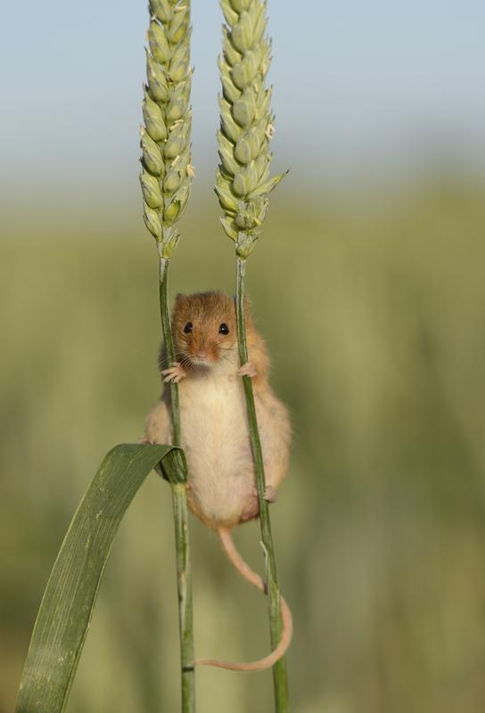
Is it worth it? The moral case
95% of Europeans feel that the environment is important to them.
77% see the conservation of biodiversity first and foremost as a moral obligation.
A healthy environment is fundamental to making human life both possible and worth living... over half of the adult population of England visit the natural environment at least once a week…

Slide 42
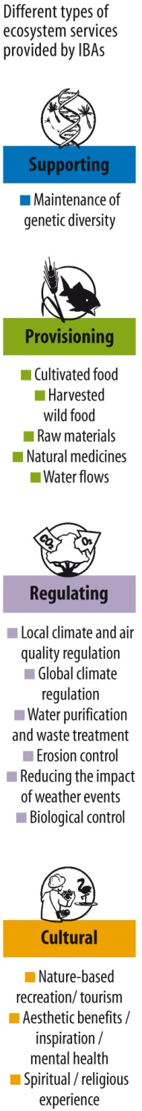
The economic case
Sites important for biodiversity also provide significant benefits to people by delivering ‘ecosystem services’ (the outputs of ecosystems from which people derive benefits) locally and globally.
But this is frequently not valued at all in decision-making impacting on the natural environment.
A recent estimate of the total value of global ecosystem services is $125-145 trillion/yr, close to twice the size of global GDP.
In England, the costs of managing nature reserves are outweighed by the benefits 9:1. (2:1 for HS2).
There is strong evidence of the benefits of biodiversity action.
Notes:
Some of these benefits are enjoyed locally (e.g. local air quality improvements), whilst others are global in their impacts (e.g. carbon sequestration by Natura 2000 sites provides global climate change mitigation benefits).

Slide 43

“The natural world, its biodiversity and its constituent ecosystems are critically important to our well-being and economic prosperity, but are consistently undervalued in conventional economic analyses and decision making. Ecosystems and the services they deliver underpin our very existence. We depend on them to produce our food, regulate water supplies and climate, and breakdown waste products. We also value them in less obvious ways: contact with nature gives pleasure, provides recreation and is known to have a positive impact on long-term health and happiness”
– UKNEA (2011)

Slide 44
Summary and Conclusions
We can afford to save biodiversity (but no guarantees of success) ; we cannot afford not to.
Conservation, particularly in lower-income countries is grossly underfunded. Without a substantial increase in funding (by at least an order of magnitude), we will fail to meet the Aichi Targets 11 and 12...and species will continue to be lost. costs.
Biodiversity-rich lower-income countries, where relative needs are highest and the greatest gains per dollar will be, require much greater support from richer countries.
Resolving the on-going conservation “funding crisis” is urgent; the longer that investments in conservation are delayed, the more the costs will grow and the less likely it is that we will meet the targets (i.e. prevent extinctions occurring)
44

Slide 45


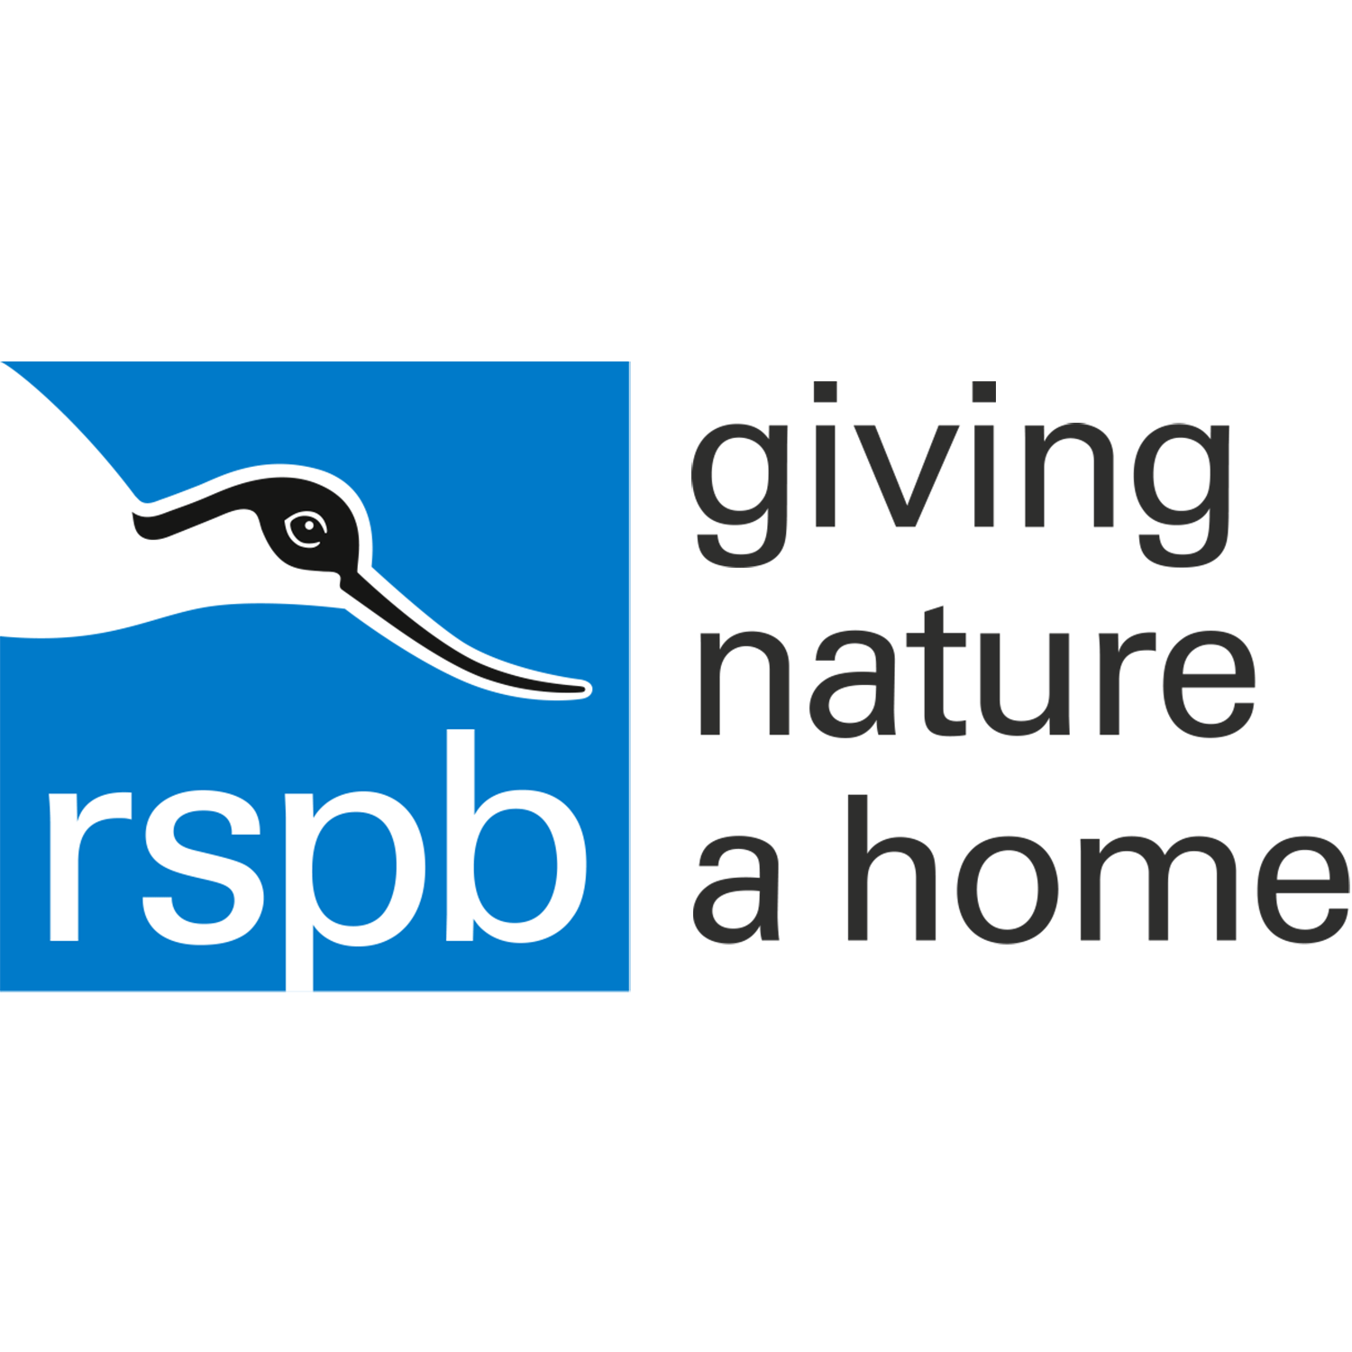


Funded by the Cambridge Conservation Initiative Collaborative Fund for Conservation
Project Team: BirdLife International, RSPB, UNEP-WCMC, University of Cambridge
45

