Slide 1
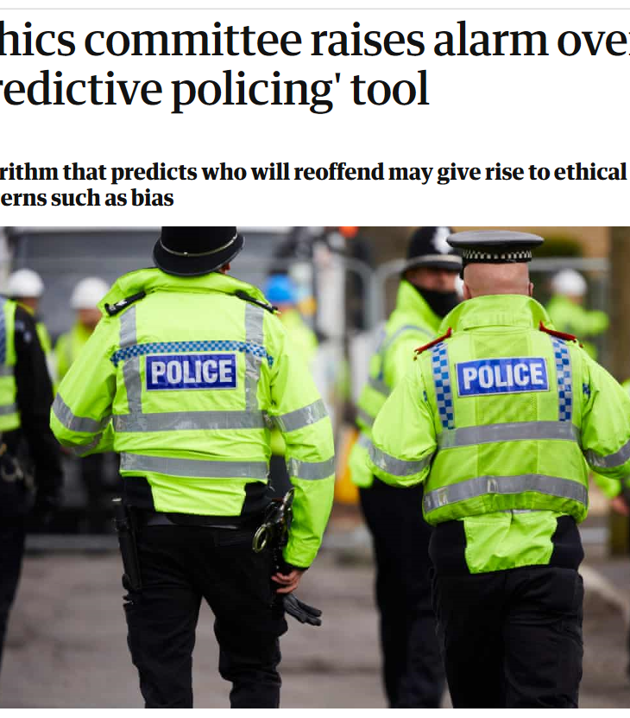
The Algorithm is Going to Get You
Should We Fear the Rise of
Artificial Intelligence in Criminal Justice?

Slide 2
Abstract: With the use of artificial intelligence techniques increasingly prominent in public discourse, there have been several recent examples of the media focussing attention on the use of algorithms in criminal justice settings.
The prevailing sentiment of these pieces has been one of strong caution. A typical consumer of these stories may be left with the sense that algorithms can only lead to at best, a biased outcome and that it would be far better to leave practitioners to their own professional judgements.
In this talk I will expand on this important debate in detail, with specific references to my experiences of working with machine-learning techniques in criminal justice forecasts in domestic abuse cases, reoffending and case solvability.
My discussion will be mostly non-technical but I draw on practical examples of the use of these methods to illustrate issues around ethics, bias and implementation.
Speaker: Matthew Bland is a PhD candidate at the Institute of Criminology and Research Manager for the Cambridge Centre of Evidence Based Policing.
During a 15-year career as a police staff member, Matthew was Head of Strategic Analysis for Norfolk and Suffolk Constabularies and concurrently completed a Master’s Degree in Applied Criminology and Police Management at Cambridge.
His recent professional and research career has predominantly focussed on the field of evidence-based policing, for which he implemented one of the first dedicated policing units in the country in 2013 and has published papers on domestic abuse and patrol strategies.
His current work and studies both focus on the application of machine-learning methods to ‘big data’, predominantly in collaboration with police forces from England and Wales.

Slide 3
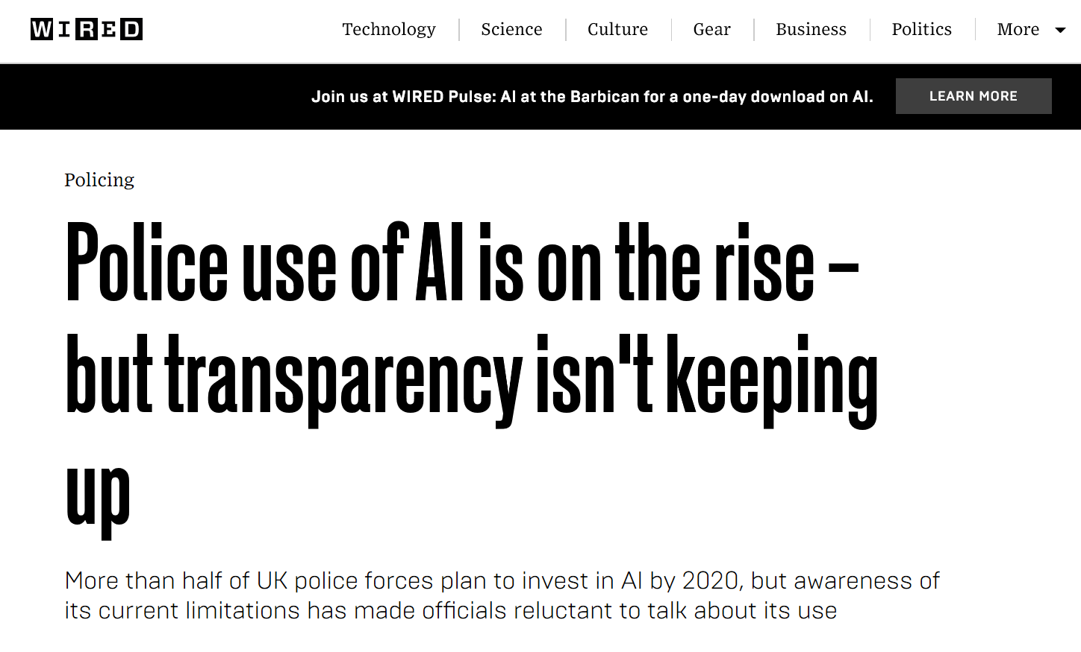

Slide 4
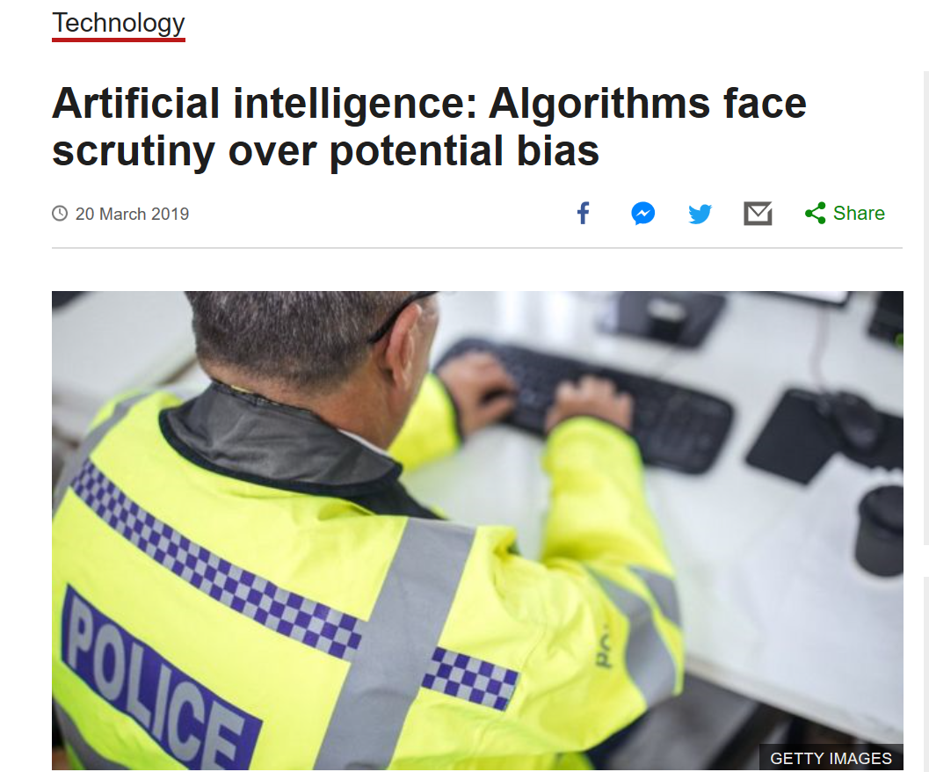

Slide 5
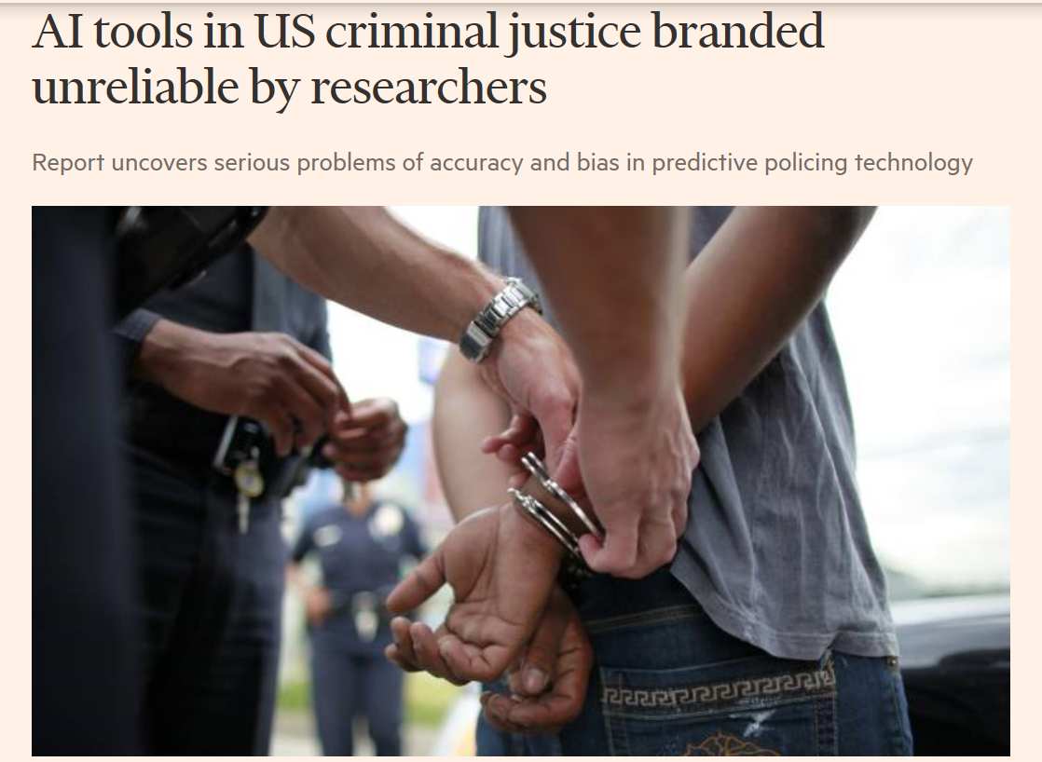

Slide 6
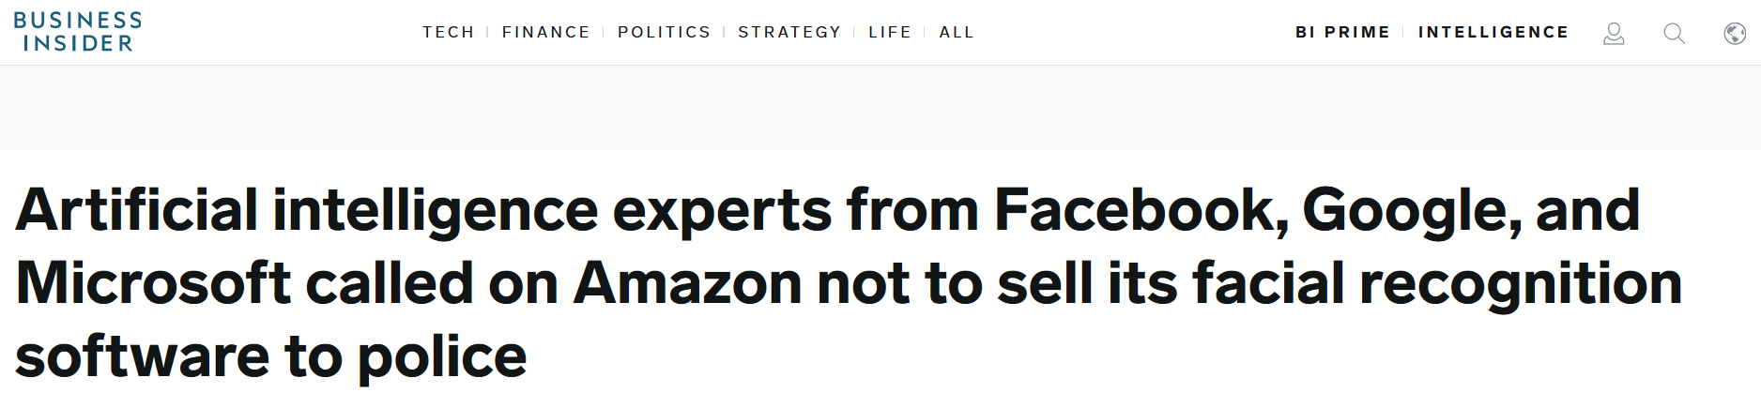

Slide 7
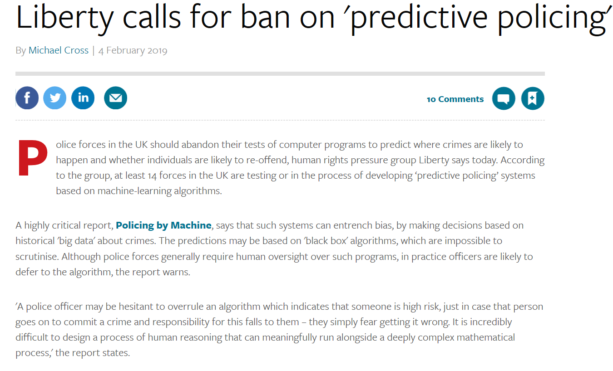

Slide 8
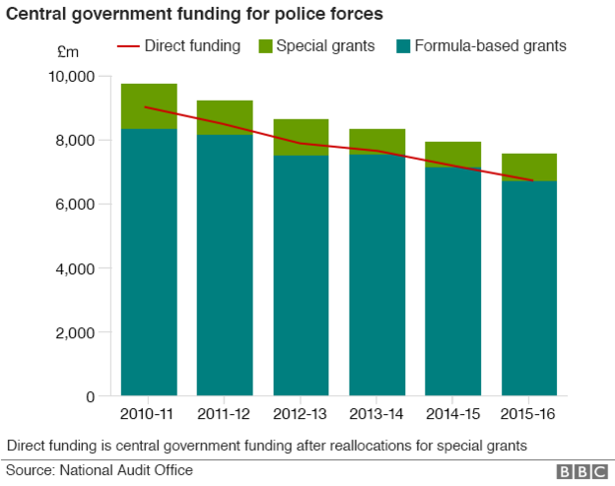
Context

Slide 9
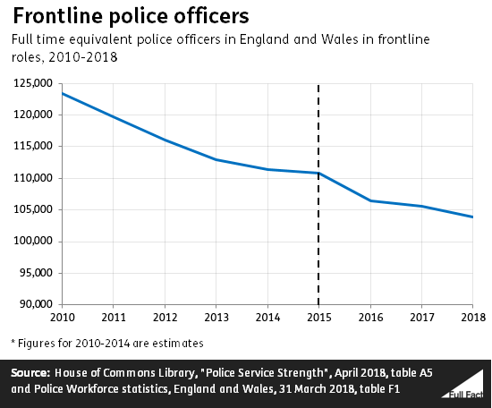

Slide 10
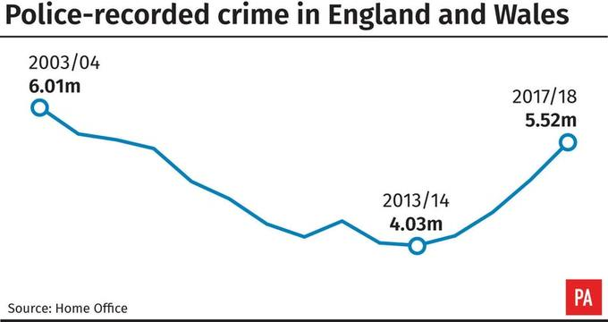
Context

Slide 11
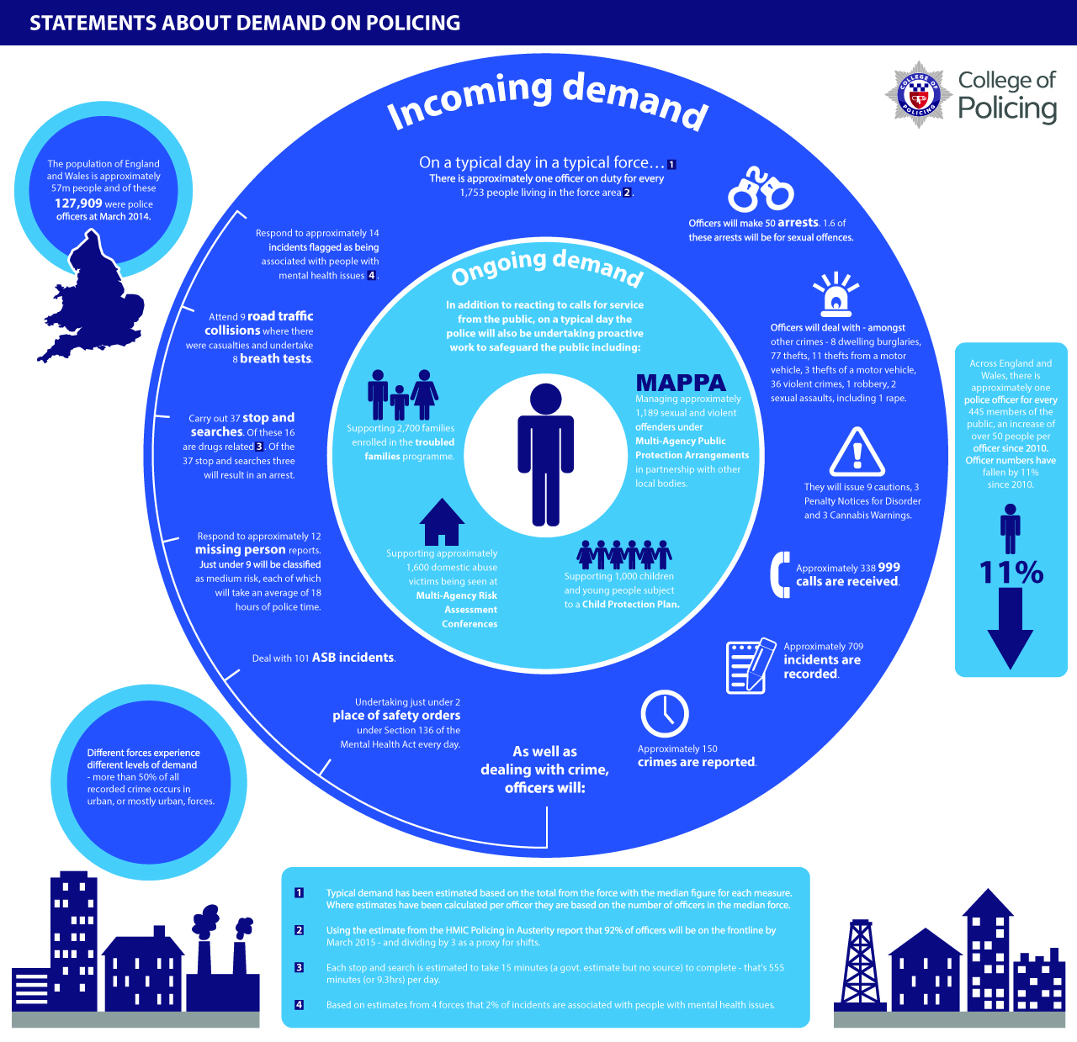

Slide 12
The Standard Model of Policing
Random Patrol
Rapid Response
Reactive Investigation

Slide 13
The Rise of Evidence Based Policing
Targeting
Testing
Tracking

Slide 14
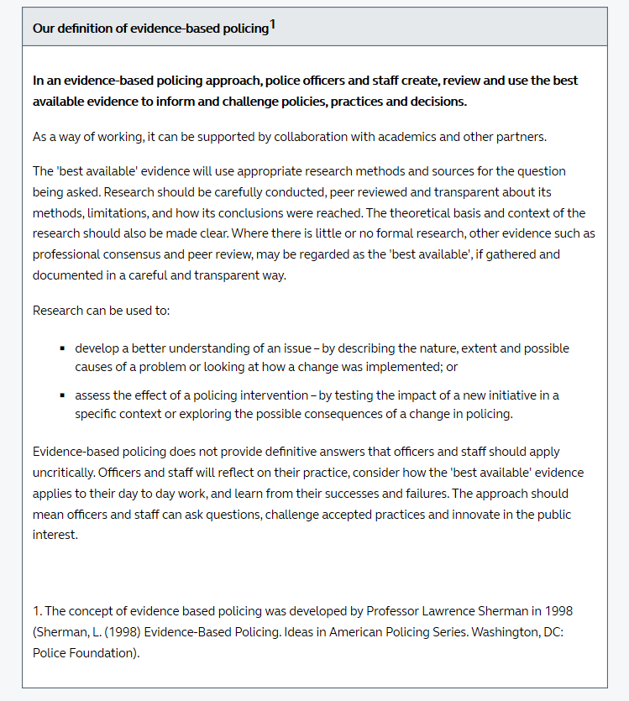




Slide 15
Potential Applications
Facial Recognition
Triage
Resource Planning
Operations
Risk Assessment

Slide 16
The potential pitfalls
Bias
Discrimination
Accuracy
Morality
Transparency

Slide 17
Applications for AI/Algorithms in Policing
Artificial Intelligence – intelligence demonstrated by machines; sometimes known as machine learning – any device that perceives its environment and takes action to maximise chances of success.
Algorithms – the specification for how to solve a problem which may involve calculation, processing or automated reasoning.

Slide 18
Case Study 1:
Simple Statistics Posing as Artificial Intelligence

Slide 19
The Problem

Slide 20
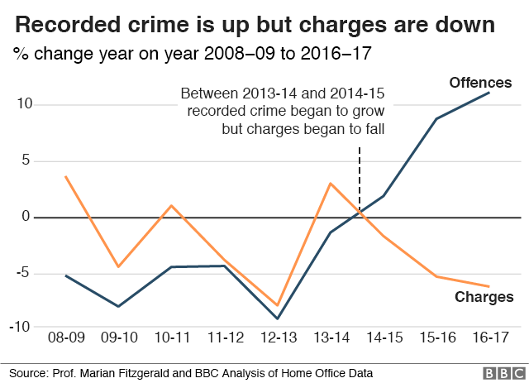
The Problem

Slide 21
The Solution?
Case Control Analysis – which case elements best ‘predict’, by correlation, a positive case outcome?

Slide 22
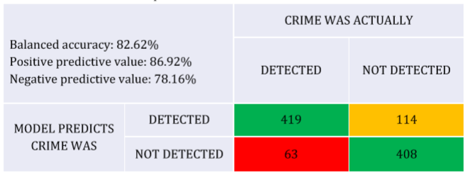
Triage by Logistic Regression

Slide 23
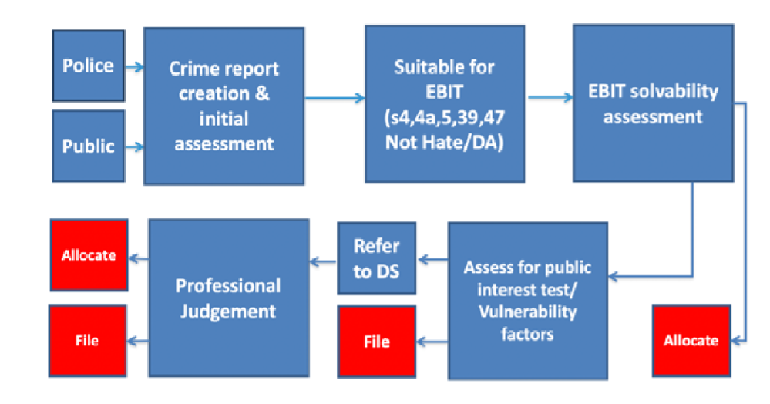
Safeguards

Slide 24
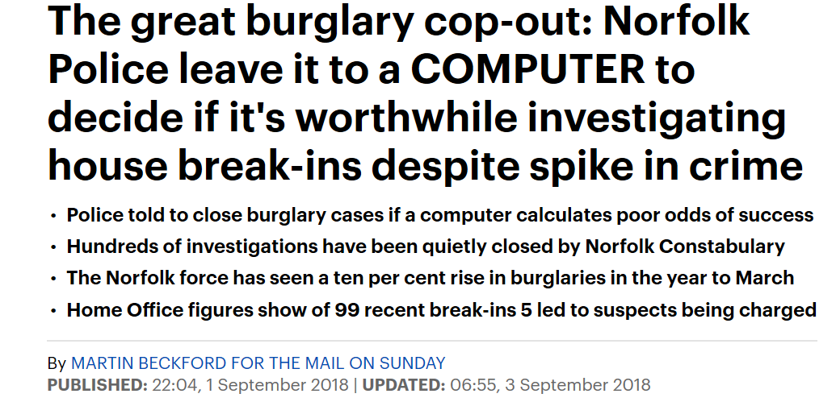
And yet…

Slide 25
Case Study 2:
Machine Learning

Slide 26
The Problem
From the thousands of individuals the police encounter each day, how can they determine who poses the most risk of high harm in the future?

Slide 27
Domestic Abuse
2 million victims each year
600,000 recorded crimes
Around 130 homicides
All crimes attended
Risk assessment in every crime
High Risk Cases -> Multi Agency Case Conference
Half of the most serious case previously unknown to police

Slide 28
The Challenge
Identify a statistical method of forecasting individuals, known or unknown to police for domestic abuse, at greater likelihood of committing serious domestic crimes in future.

Slide 29
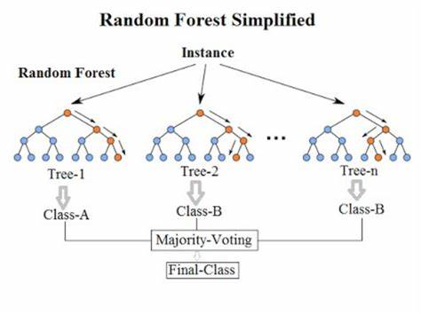
The Solution…

Slide 30
Random Forests - Advantages
1. Allow processing of large volumes of independent variables
2. No need for causal relationship between independent and dependent variables
3. Gives calibration control to allow influence over bias towards a stated outcome
4. Validates results against a partitioned sub-sample

Slide 31
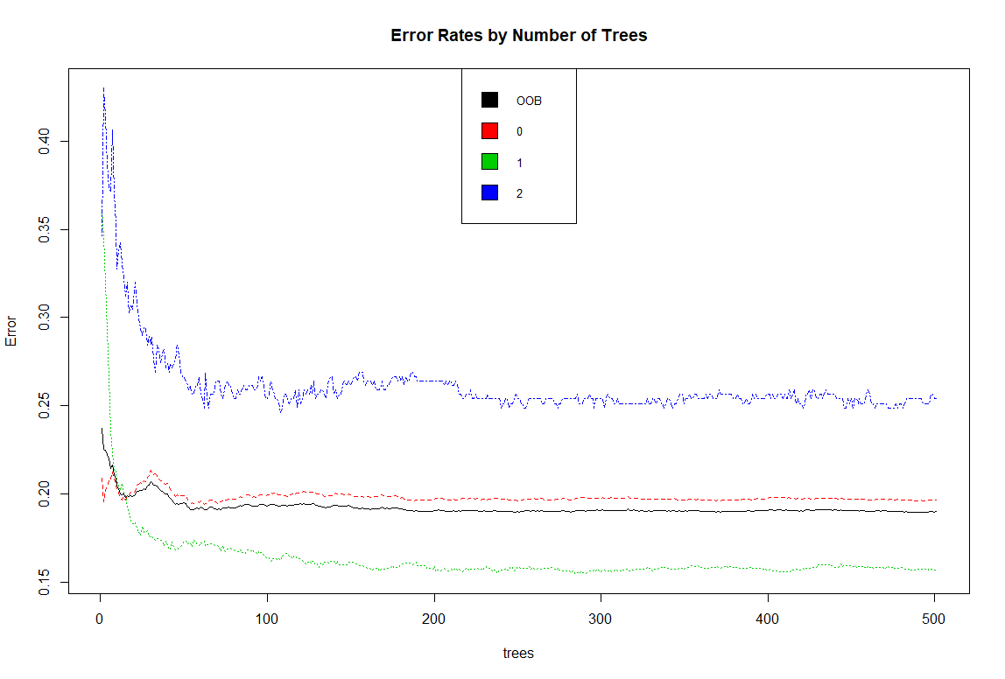

Slide 32
Non-serious domestic abuse in two years
No domestic abuse in two years
Serious domestic abuse in two years
Wasteful Forecasts
Harmful Forecasts

Slide 33
81% of serious domestic abuse cases successfully predicted
But…
94 out of 100 serious forecasts would be incorrect…
Acceptable?

Slide 34
Discussion
Ethical questions – should police even do this? Is professional judgement better?
Mechanical questions – can the police do this?
Areas for attention – regulation and oversight, co-ordination,

Slide 35
Thank you
Matthew Bland
Research Manager
Cambridge Centre for Evidence Based Policing Ltd.
matthew_bland@outlook.com
@mattblandccebp
07539 296337

